Slide 1
Automatic Differentiation
Zuzana Kukelova
Andrew Fitzgibbon
Filip Srajer

Slide 2
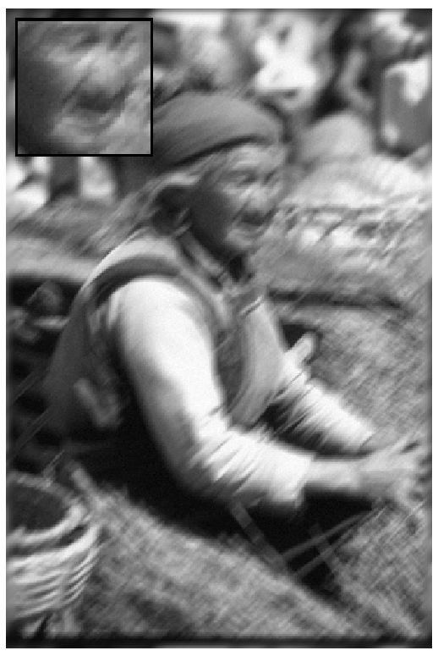
Motivation
Hand tracking
3D reconstruction
Gaussian mixture model fitting
[Zoran & Weiss, ICCV 11]
Notes:
Fitting rigid hand mesh to 3D data
Deblurring image – learning GMM prior
3D reconstruction – doing bundle adjustment

Slide 3
Computing Derivatives
By hand ☹
Finite differences
Symbolic differentiation
Automatic differentiation

Slide 4
Computing Derivatives
differentiation by hand
$$f\left(x\right)=x^{2}$$
$$df(x)=2x$$
programming
programming
f(x)
{return x*x;}
automatic/symbolic differentiation
df(x)
{return 2*x;}
finite differences
df(x)
{return (f(x+h)-h)/h;}
Notes:
manual – adv: exact, optimized-dependent on programmer; dis: error-prone, human effort

Slide 5
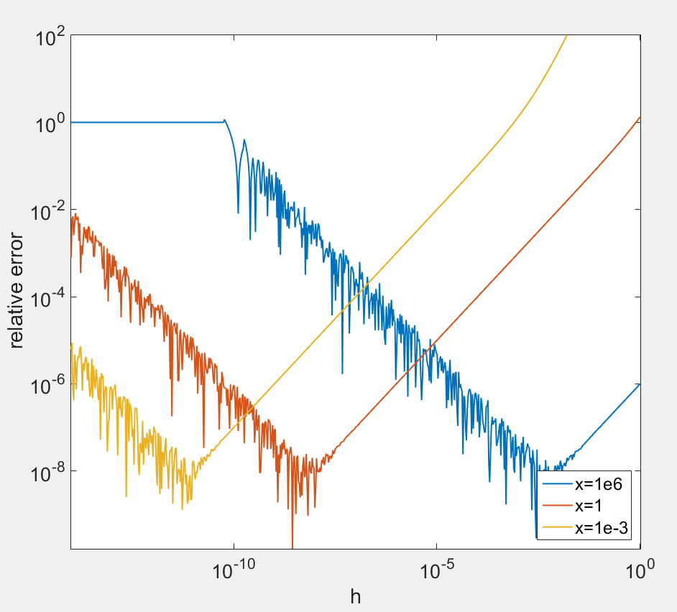
Why Not Finite Differences?
$f\left(x\right)=x^{3}$
$df\left(x\right)=3x^{2}$
$df\left(x\right)≈ \frac{f\left(x+h\right)−f(x)}{h}$
Precise enough?
$n+1$ evaluations for $R^{n}→R^{m}$
Notes:
adding small to big
subtracting almost approx. equal

Slide 6
Symbolic vs. Automatic
$$f\left(x\right)=sin⁡(sin⁡(sin⁡(x)))$$ | Symbolic | Symbolic optimized | Automatic
f(x) { for i in [1 2 3] { x = sin(x); } return x; }
Symbolic
df(x) { dx = cos(sin(sin(x)))* cos(sin(x))* cos(x); return dx; }
Symbolic optimized
df(x) { tmp = sin(x); dx = cos(sin(tmp))* cos(tmp)* cos(x); return dx; }
Automatic
df(x) { dx = 1; for i in [1 2 3] { dx = cos(x)*dx; x = sin(x); } return dx; }
Notes:
adv: can be very fast
dis: unable to handle big problems – compilation crash, only fixed loop

Slide 7
How Does AD Work?
$$f\left(x_{1},x_{2}\right)=\ln\left(x_{1}\right)+x_{1}x_{2}$$
$$v_{1}=\ln\left(x_{1}\right)$$
f
$$v_{2}=x_{1}x_{2}$$
$$v_{3}=v_{1}+v_{2}$$
$${\dot{v}}_{3}={\dot{v}}_{1}+{\dot{v}}_{2}=\frac{1}{x_{1}}+x_{2}$$
+
v₃
dv2 = dx1*x2 + x1*dx2;
$${\dot{v}}_{1}=\frac{1}{x_{1}}{\dot{x}}_{1}=\frac{1}{x_{1}}$$
dv3 = dv1 + dv2;
return dv3;
df(x1,dx1,x2,dx2)
{
}
dv1 = dx1/x1;
$${\dot{v}}_{2}={\dot{x}}_{1}x_{2}+x_{1}{\dot{x}}_{2}=x_{2}$$
v₁
ln
*
v₂
$${\dot{x}}_{1}=1 (seed)$$
$${\dot{x}}_{2}=0 (seed)$$
x₁
x₂
Notes:
This is forward mode.

Slide 8
Reverse Mode
$$\overline{v_{i}}=\frac{∂f}{∂v_{i}}$$
$$f\left(x_{1},x_{2}\right)=\ln\left(x_{1}\right)+x_{1}x_{2}$$
$$v_{1}=\ln\left(x_{1}\right)$$
f
$$v_{2}=x_{1}x_{2}$$
$$v_{3}=v_{1}+v_{2}$$
$$\overline{f}=\overline{v_{3}}=1 (seed)$$
+
v₃
df(x1,x2,dv3)
{
}
dx1 = dv1/x1 + dv2*x2
return (dx1,dx2);
dx2 = dv2*x1
dv1 = dv3;
dv2 = dv3;
$$\overline{v_{1}}=\overline{v_{3}} 1=1$$
$$\overline{v_{2}}=\overline{v_{3}} 1=1$$
v₁
ln
*
v₂
$$\overline{x_{1}}=\overline{v_{1}}\frac{1}{x_{1}}+\overline{v_{2}}x_{2}=\frac{1}{x_{1}}+x_{2}$$
$$\overline{x_{2}}=\overline{v_{2}}x_{1}=x_{1}$$
x₁
x₂

Slide 9
Different Approaches
Source transformation
Operator overloading
double f(double x)
{return x*x;}
double df(double x)
{return 2*x;}
template<class T>
T f(T x)
{return x*x;}
class adouble
{
double x, dx;
};
adouble operator+(adouble rhs) -> res
{
res.x = x + rhs.x;
res.dx = dx + rhs.dx;
}
adouble operator*(adouble rhs) -> res
{
res.x = x*rhs.x;
res.dx = dx*rhs.x + x*rhs.dx;
}

Slide 10
Tested Tools
OO – operator overloading, ST – source transformation
F – forward, R – reverse
Language | Tool | Approach | Mode
C++ | Adept | OO | F, R
C++ | ADIC2 | ST | F, R
C++ | ADOL-C | OO | F, R
C++ | Ceres | OO | F
C++ | clad | ST via compiler | F
C/Fortran | Tapenade | ST | F, R
F# | DiffSharp | OO | F, R
MATLAB | ADiGator | ST via OO | F
MATLAB | ADiMat | OO with help of ST | F, R
MATLAB | MuPAD | Symbolic
Julia | ForwardDiff | OO | F
Python | Autograd | OO | R
Python | Theano | Symbolic
compilation issues
no arrays
syntactically incorrect output

Slide 11
Problems
Gaussian Mixture Model Fitting
Bundle Adjustment
Hand Tracking

Slide 12
Gaussian Mixture Model
$$p\left(x;w,μ,Σ\right)=\sum_{k=1}^{K}{w_{k}\frac{1}{\sqrt{\det\left(2πΣ_{k}\right)}}\exp\left(−\frac{1}{2}{\left(x−μ_{k}\right)}^{⊤}Σ_{k}^{−1}\left(x−μ_{k}\right)\right)}$$
$Σ \text{is} \text{positive}\text{−}\text{semidefinite} ⇔Σ^{−1}=Q^{T}Q$, where $Q=\left[\begin{matrix}\exp\left(q_{1}\right) & 0 & 0 & … \\ l_{1} & \exp\left(q_{2}\right) & 0 & … \\ l_{2} & l_{d} & exp⁡(q_{3}) & … \\ ⋮ & ⋮ & ⋮ & ⋱\end{matrix}\right]$
$$\sum_{k=1}^{K}{w_{k}=1}⇔w_{k}=\frac{\exp\left(α_{k}\right)}{\sum_{k^{′}=1}^{K}{exp⁡(α_{k^{′}})}}$$
Notes:
Cholesky decomposition

Slide 13
GMM Log-likelihood with Prior
$$\log{L\left(α,μ,q,l\right|x)}=\log{\prod_{i=1}^{N}{p\left(x_{i};α,μ,q,l\right)}}$$
$$\sum_{i=1}^{n}{logsumexp\left({\left[α_{k}+sum\left(q_{k}\right)−\frac{1}{2}{\left\|Q\left(q_{k},l_{k}\right)\left(x_{i}−μ_{k}\right)\right\|}^{2}\right]}_{k=1}^{K}\right)−n logsumexp\left(α\right)}+C$$
$$+\frac{γ^{2}}{2}\sum_{k=1}^{K}{\left({\left\|\exp\left(q_{k}\right)\right\|}^{2}+{\left\|l_{k}\right\|}^{2}\right)−m sum\left(q_{k}\right)−C_{2}}$$
hyperparameters: $γ∈ℝ,m∈ℤ, m≥−1$

Slide 14
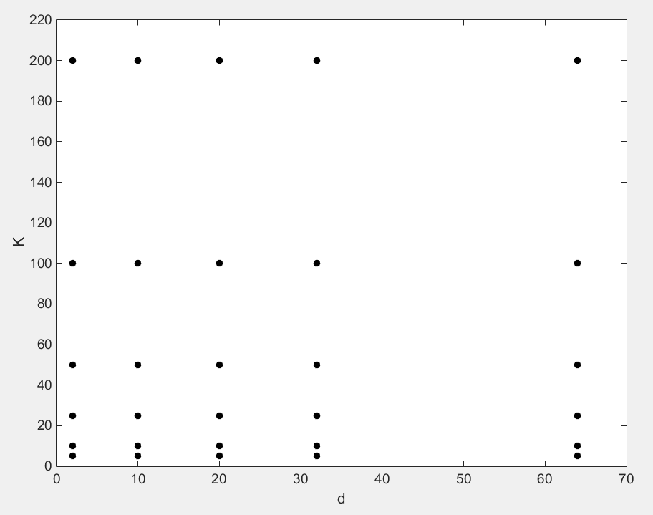
Problem Size
Sample from a grid
Up to dimension $d=64$
Up to $K=200$ components
[Zoran & Weiss, ICCV 11]

Slide 15
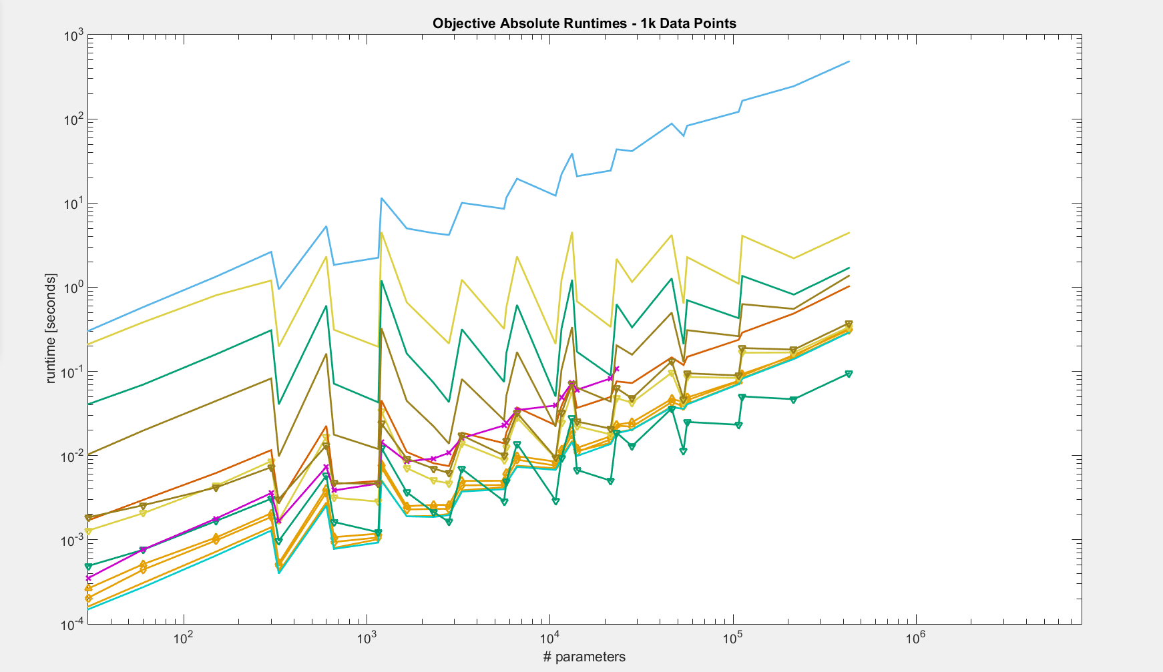
Python
Theano
MATLAB
Julia
F#, Julia (vector)
Theano (vector), MuPAD
MATLAB (vector)
C, C++ (clean, Eigen, Eigen vector)

Slide 16
Python
Theano
MATLAB
Julia
F#
Theano (vector), Julia (vector)
C, C++ (clean, Eigen, Eigen vector)
MATLAB (vector)
MuPAD

Slide 17
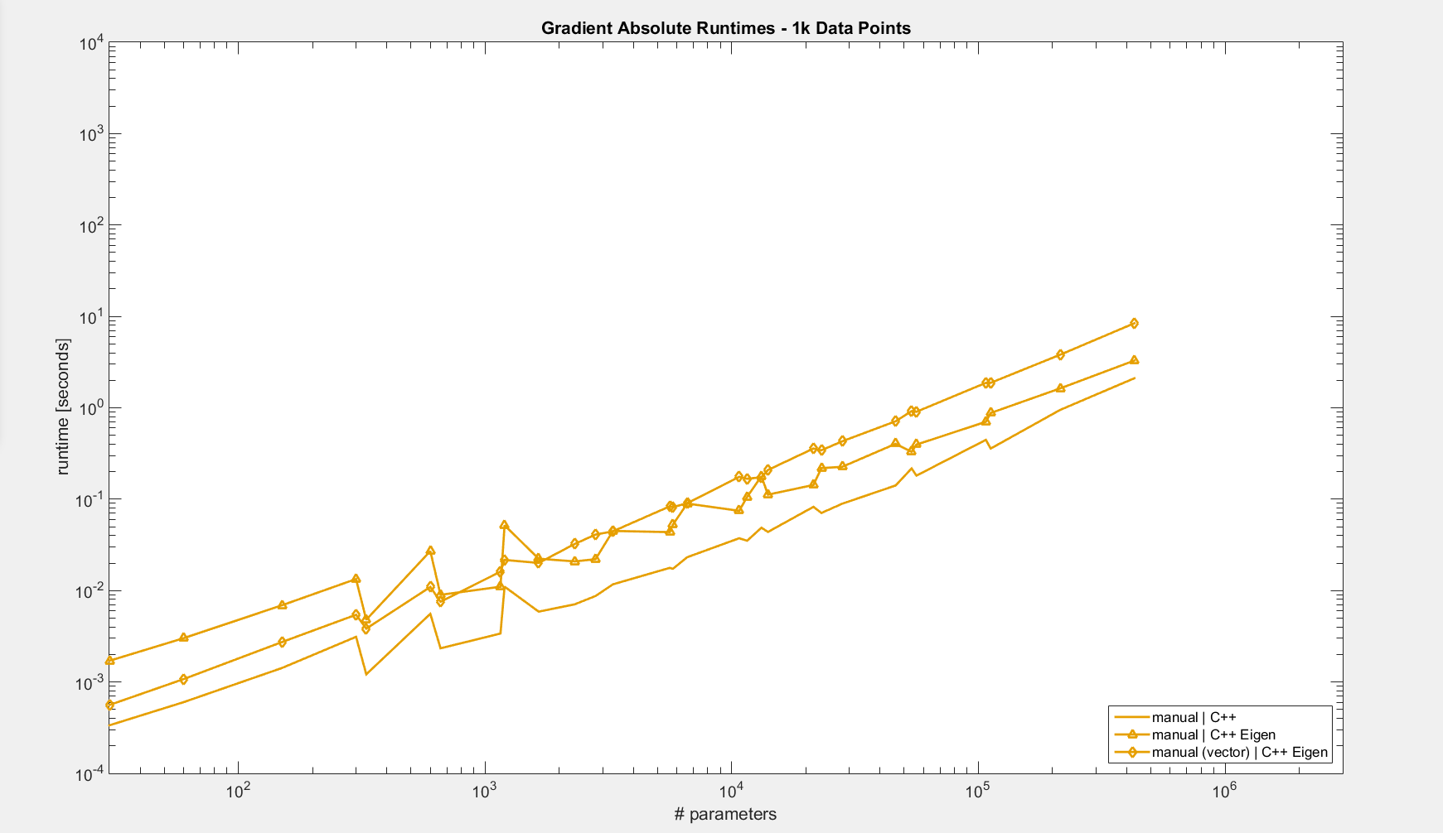
Manual (Eigen vector)
Manual (Eigen)
Manual (C++)

Slide 18
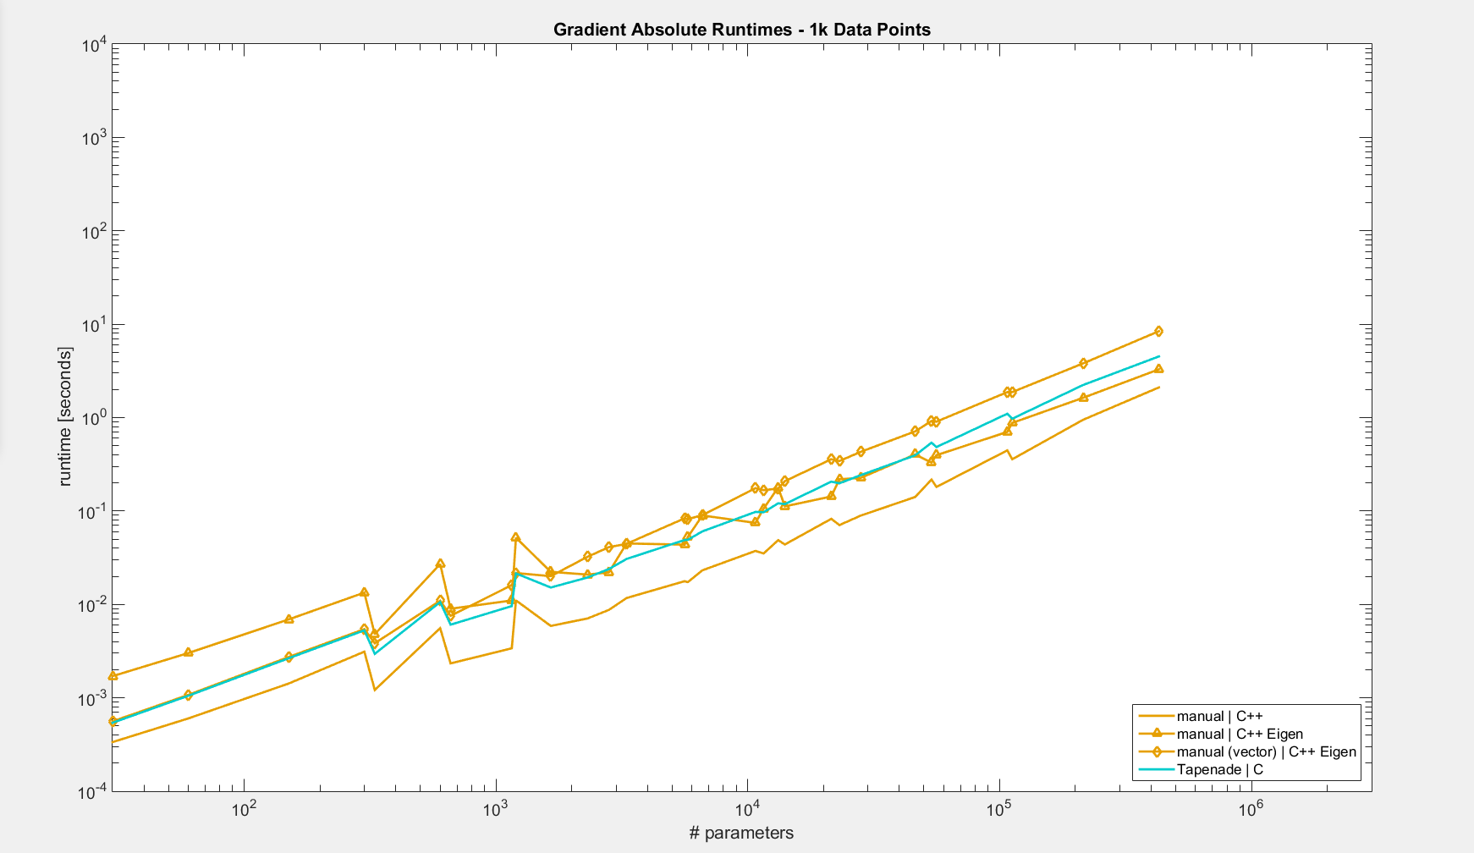
Manual (Eigen vector)
Tapenade,
Manual (Eigen)
Manual (C++)

Slide 19
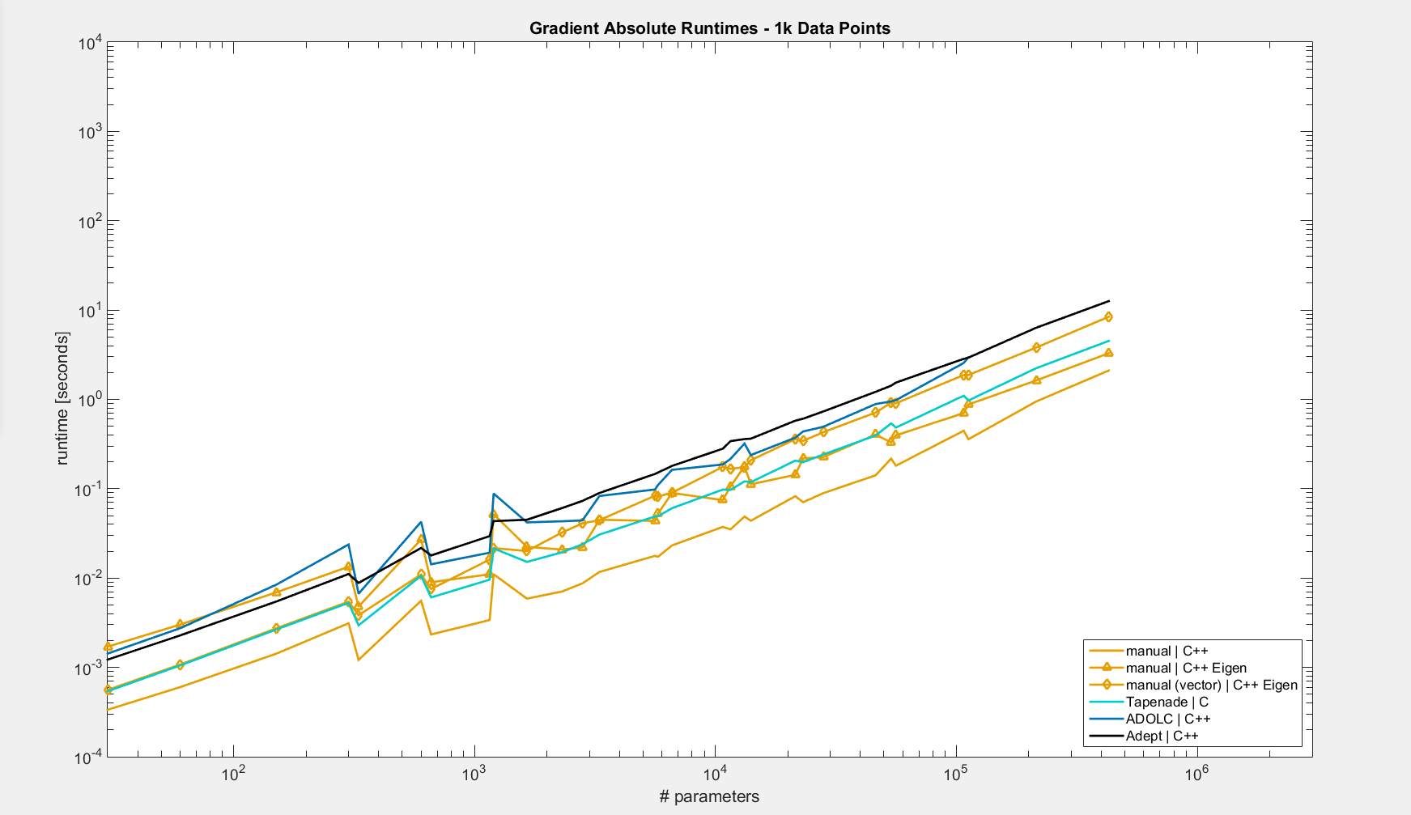
Adept
Manual (Eigen vector)
ADOLC
Tapenade,
Manual (Eigen)
Manual (C++)

Slide 20
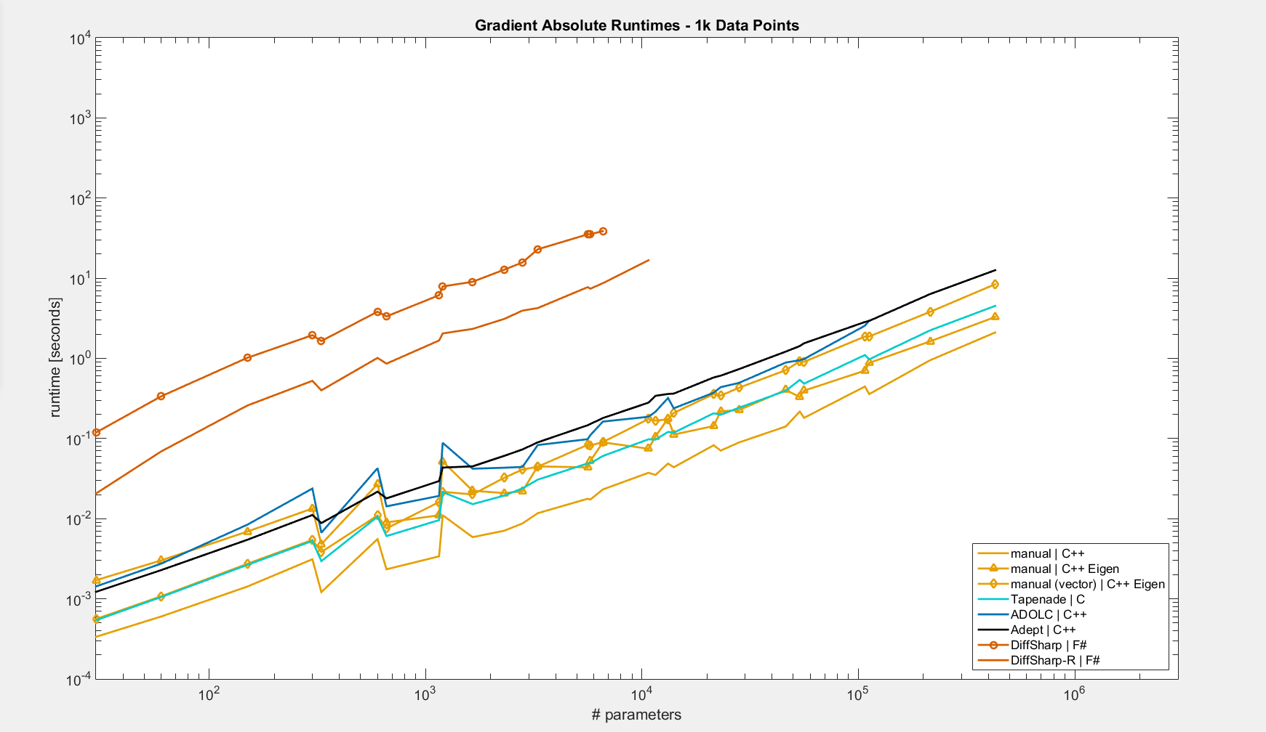
DiffSharp-R
DiffSharp
Adept
Manual (Eigen vector)
ADOLC
Tapenade,
Manual (Eigen)
Manual (C++)

Slide 21
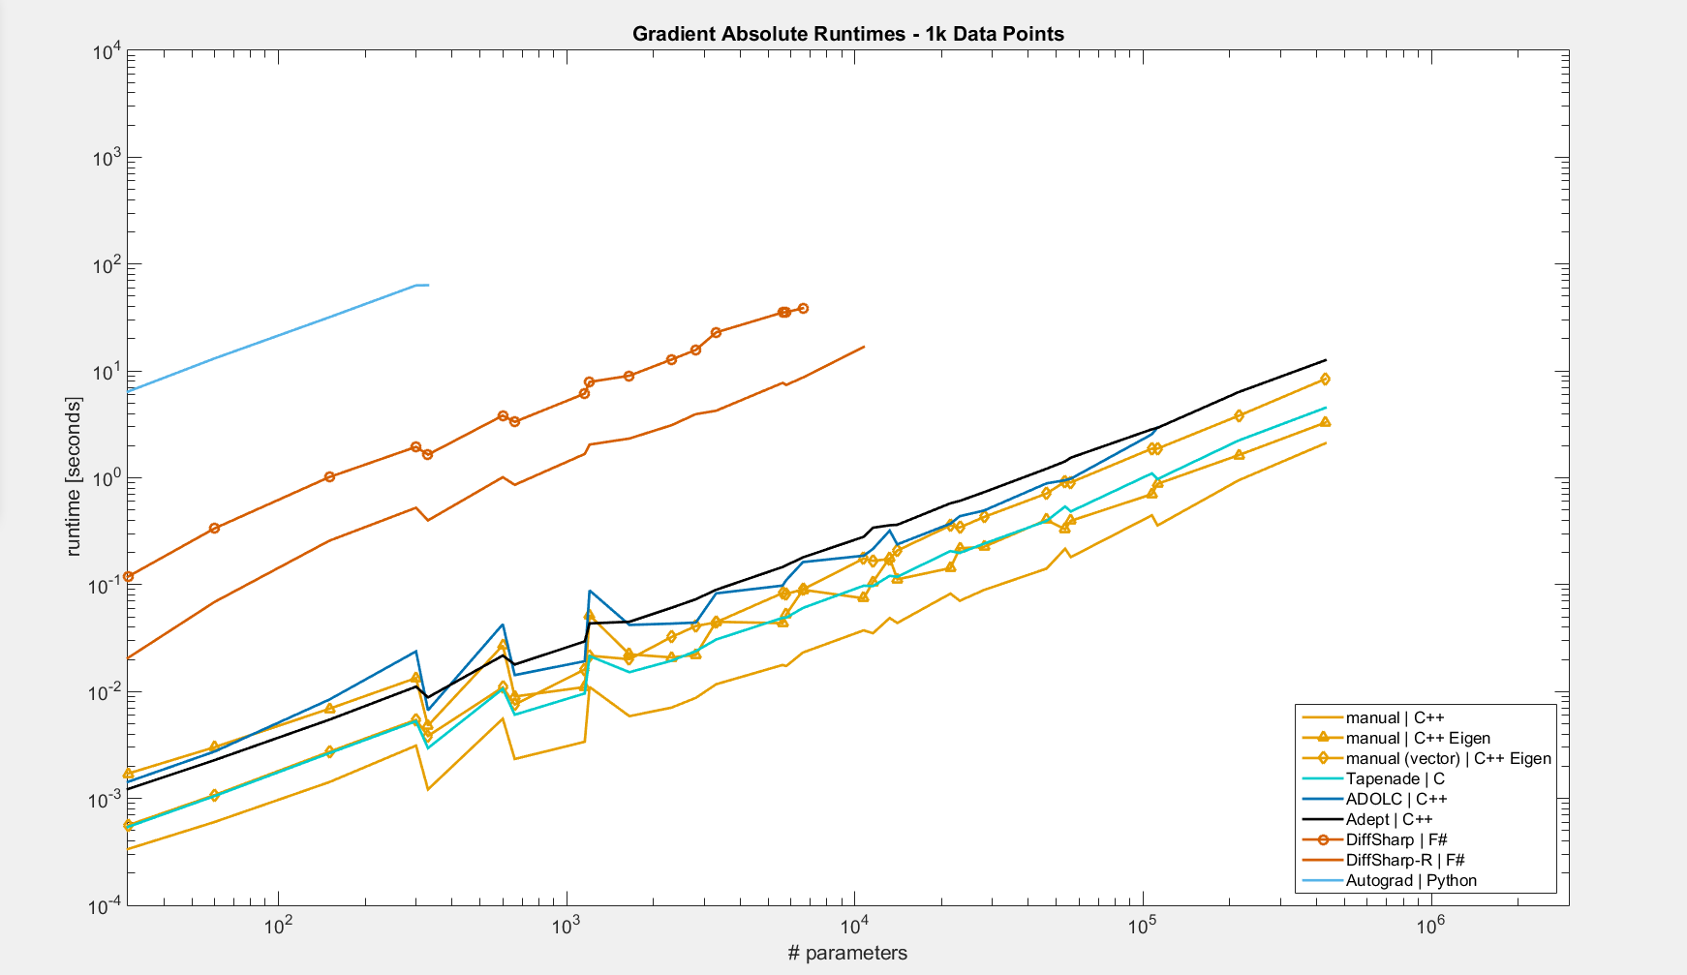
Autograd
DiffSharp-R
DiffSharp
Adept
Manual (Eigen vector)
ADOLC
Tapenade,
Manual (Eigen)
Manual (C++)

Slide 22
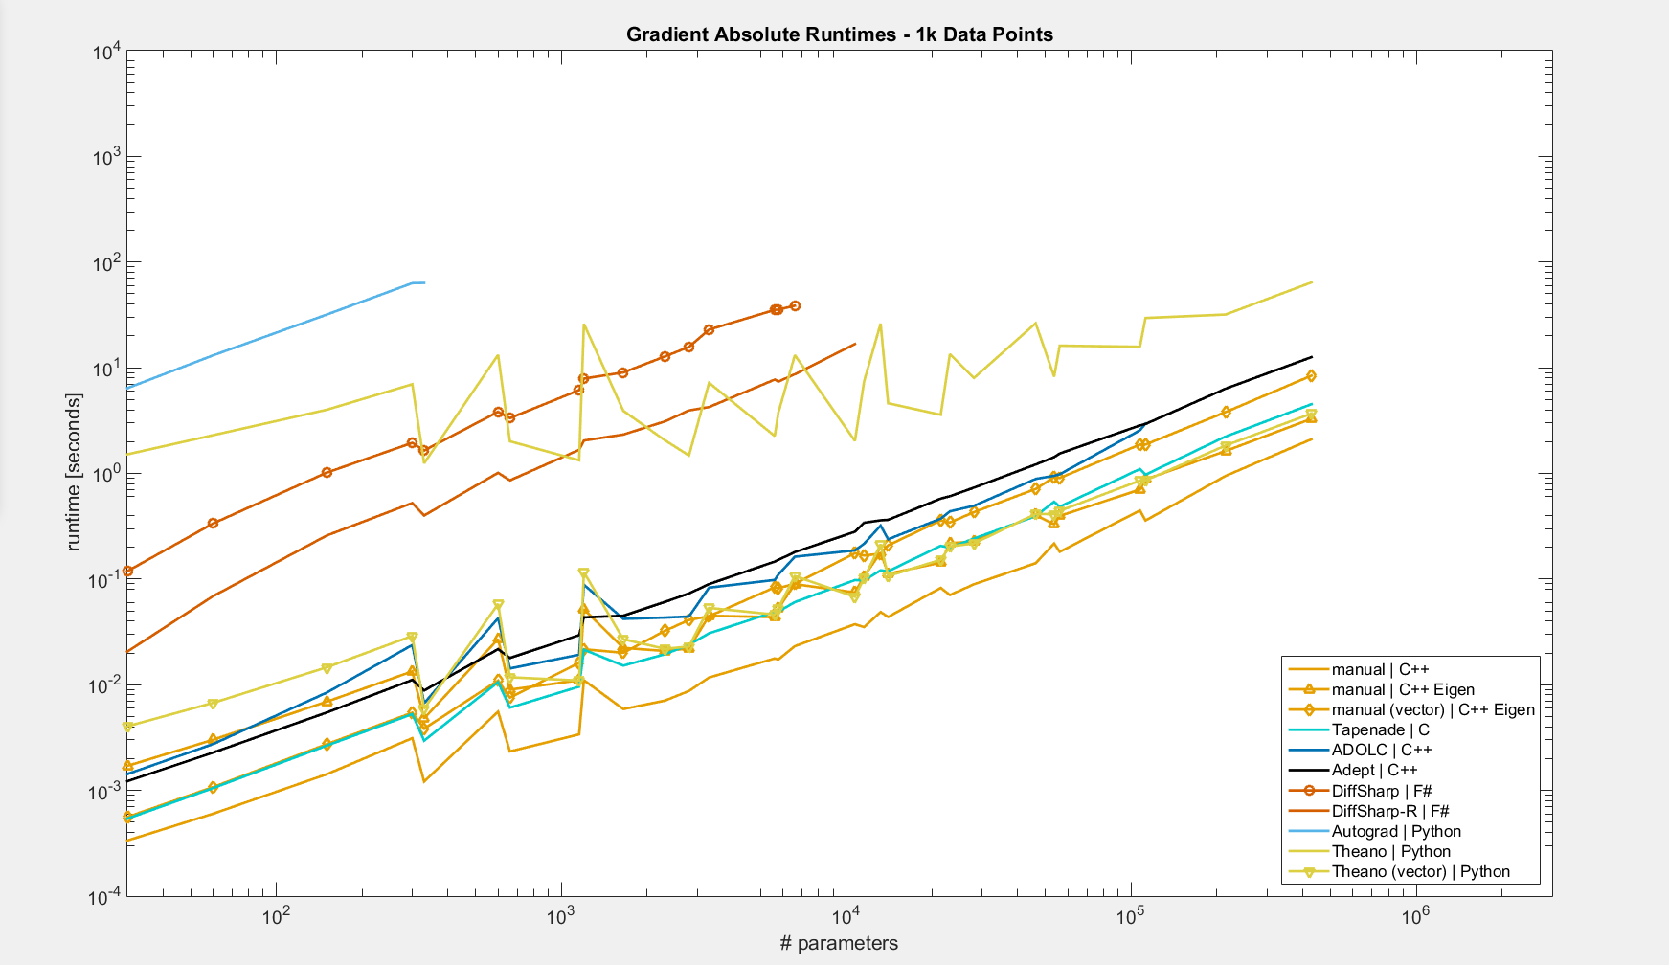
Autograd
DiffSharp-R
DiffSharp
Theano
Adept
Manual (Eigen vector)
ADOLC
Tapenade, Theano (vector),
Manual (Eigen)
Manual (C++)

Slide 23
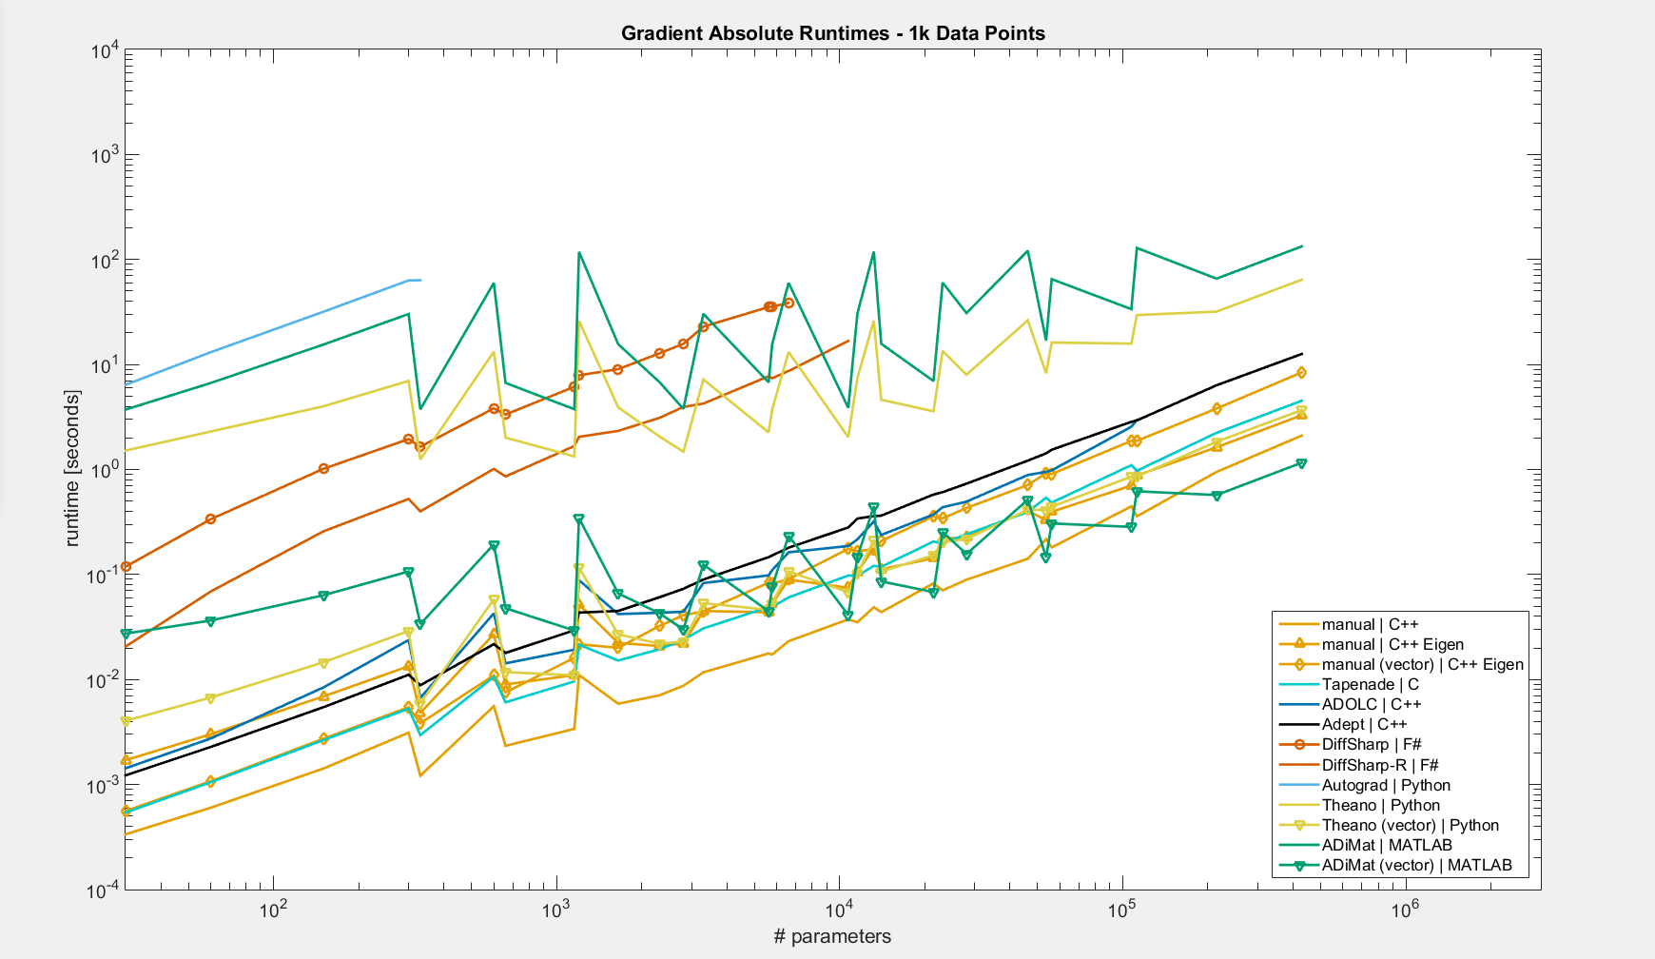
Autograd
DiffSharp-R
AdiMat
DiffSharp
Theano
Adept
Manual (Eigen vector)
ADOLC
Tapenade, Theano (vector),
Manual (Eigen)
Manual (C++)
ADiMat (vector)

Slide 24
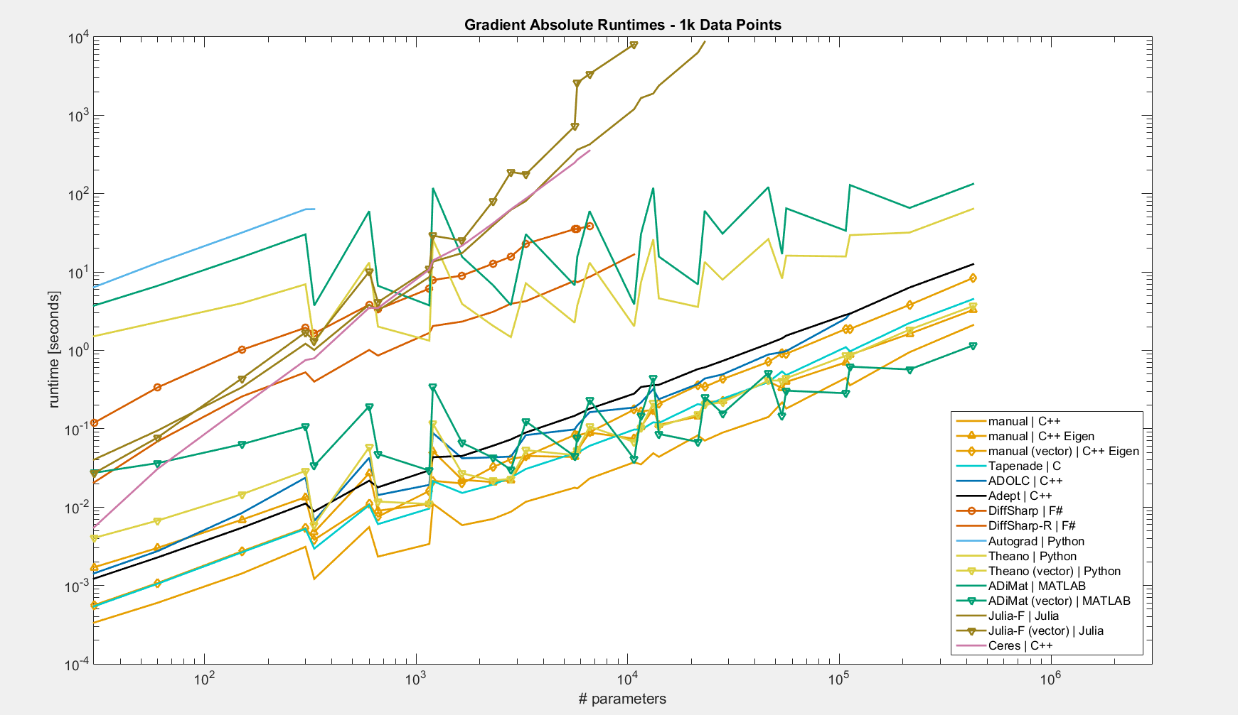
Julia, F (vector)
Julia, F
Ceres
Autograd
DiffSharp-R
AdiMat
DiffSharp
Theano
Adept
Manual (Eigen vector)
ADOLC
Tapenade, Theano (vector),
Manual (Eigen)
Manual (C++)
ADiMat (vector)

Slide 25
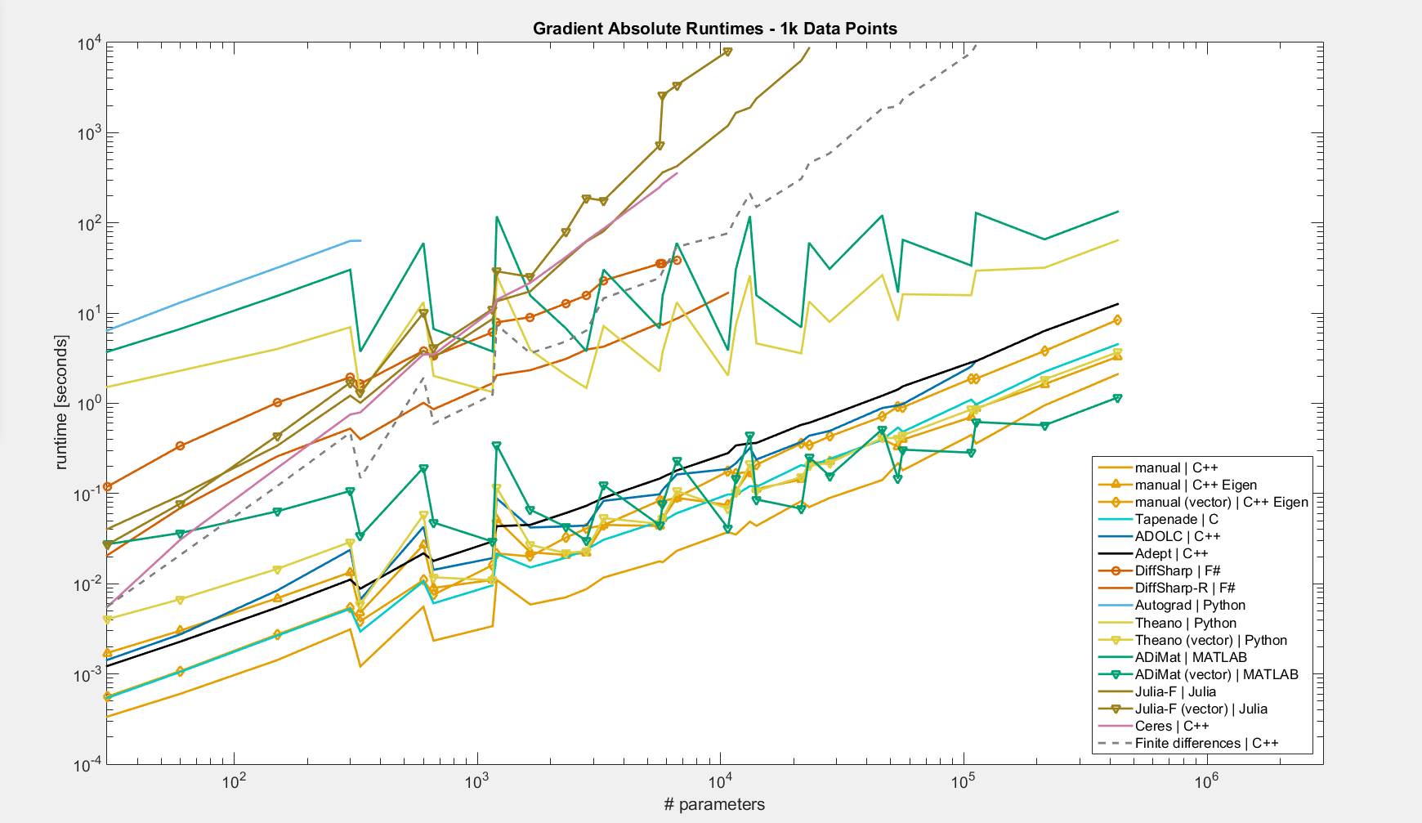
Julia, F (vector)
Julia, F
Finite Differences (C++)
Ceres
Autograd
DiffSharp-R
AdiMat
DiffSharp
Theano
Adept
Manual (Eigen vector)
ADOLC
Tapenade, Theano (vector),
Manual (Eigen)
Manual (C++)
ADiMat (vector)

Slide 26
Split Objective Function
$$f\left(θ\right)=\sum_{i=1}^{n}{g\left(x_{i},θ\right)}+h(θ)$$
$$∇f\left(θ\right)=\sum_{i=1}^{n}{∇g\left(x_{i},θ\right)}+∇h(θ)$$

Slide 27
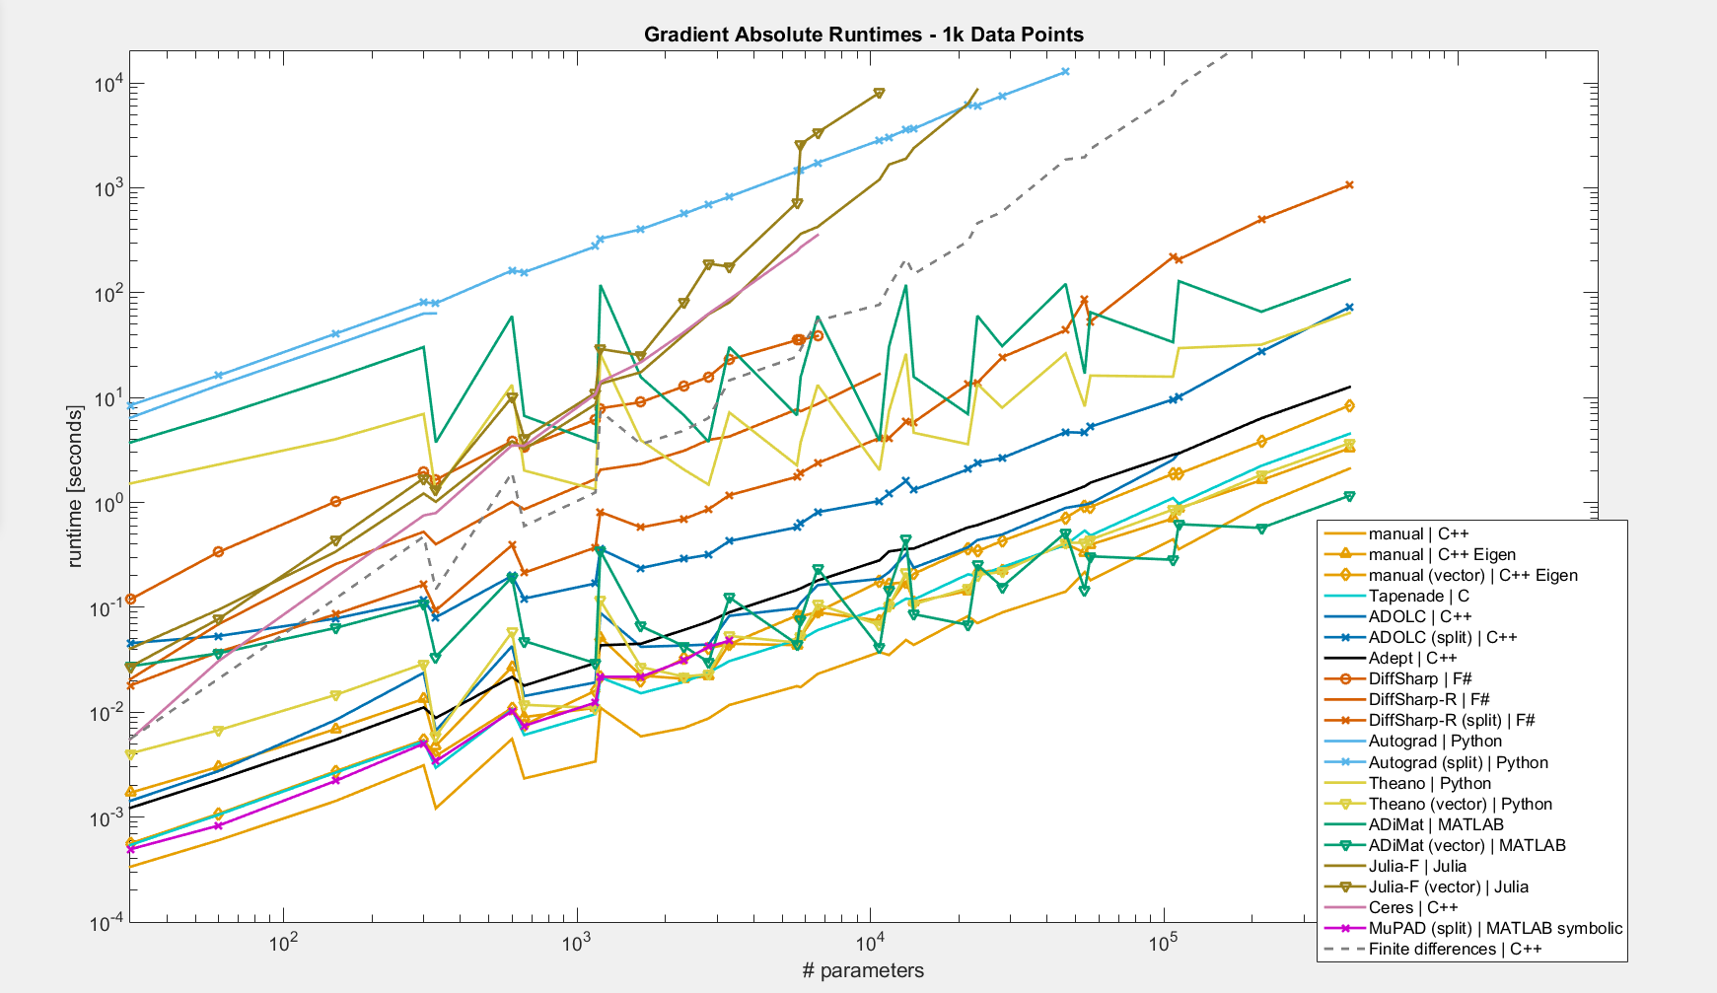
Autograd (split)
DiffSharp-R (split)
ADOLC (split)
MuPAD (split)

Slide 28
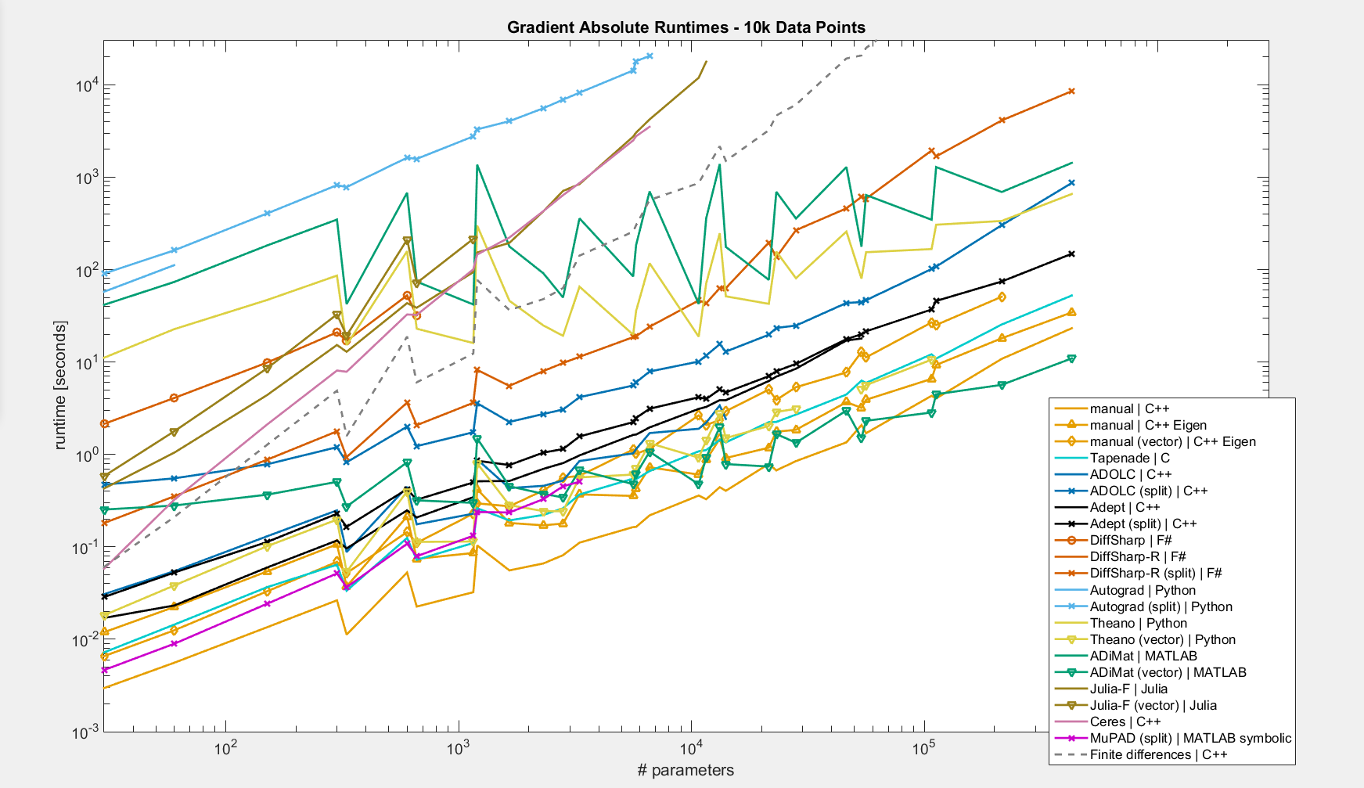
Adept (split)

Slide 29
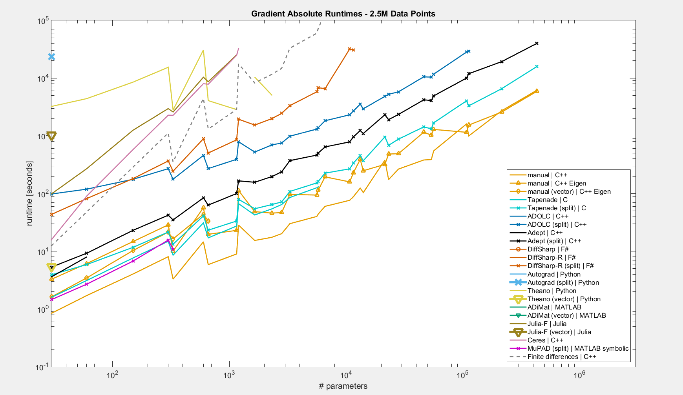
timeout
timeout
timeout
timeout
Tapenade (split)

Slide 30
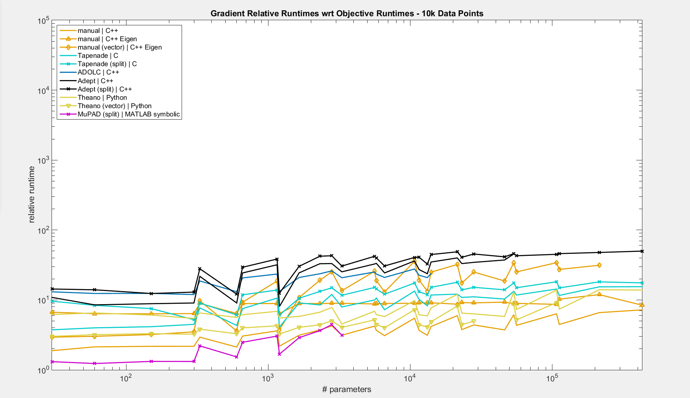
50
6

Slide 31
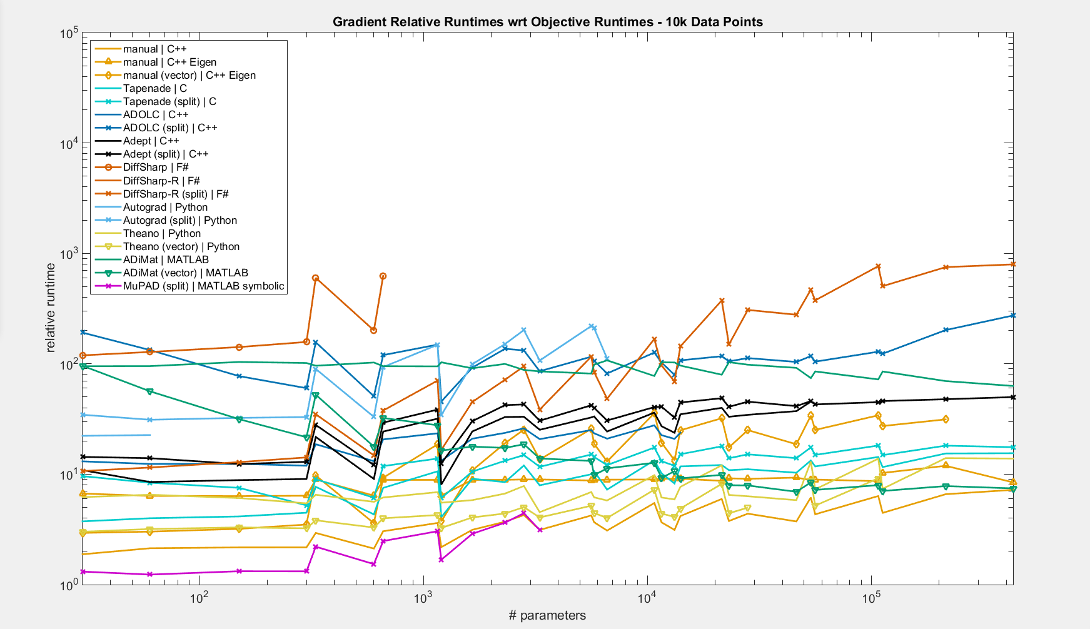
50
6

Slide 32
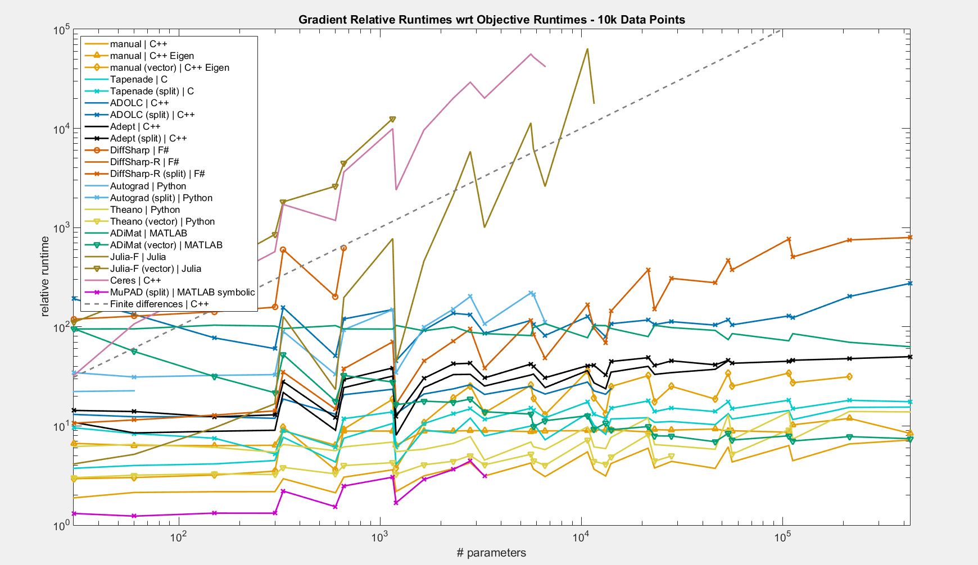
50
6

Slide 33
Tested Tools - GMM
OO – operator overloading, ST – source transformation
F – forward, R – reverse
Language | Tool | Approach | Mode | Ease of use* | Rejection reason
C++ | Adept | OO | F, R | +
C++ | ADOL-C | OO | F, R | +
C++ | Ceres | OO | F | + | no reverse mode
C/Fortran | Tapenade | ST | F, R | - -
F# | DiffSharp | OO | F, R | +
MATLAB | ADiMat | OO with help of ST | F, R | + + | memory crash
MATLAB | MuPAD | Symbolic |  | - | compilation crash
Julia | ForwardDiff | OO | F | + | no reverse mode
Python | Autograd | OO | R | 0 | too slow
Python | Theano | Symbolic |  | - | memory crash
*ease of use score can be subjective

Slide 34
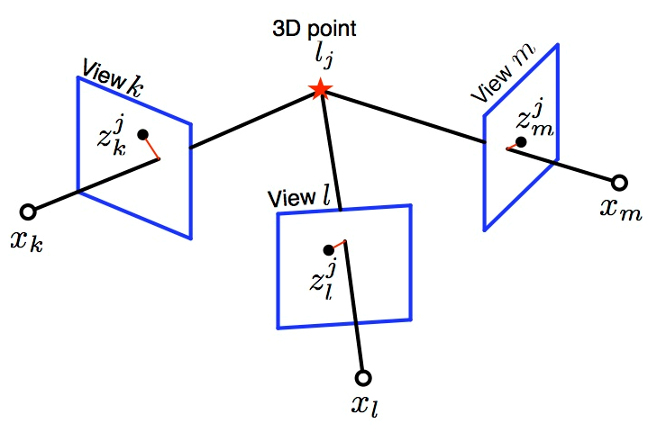
Bundle Adjustment
Parameters:
$camera∈ℝ^{11}$
$3D point∈ℝ^{3}$
$weight∈ℝ$
Data:
$measurement∈ℝ^{2}$
Error
$reprojection error=weight ∗(project\left(camera,point\right)−measurement)$
$weight error=1 −{weight}^{2}$
[http://vindelman.technion.ac.il/ResearchProjects/LBA/ThreeViewGeometry.jpg]

Slide 35
Bundle Adjustment
$$project\left(r, C, f, x_{0},κ,X\right)= distort\left(κ,p2e\left(rodriguez\left(r,X−C\right)\right)\right)f+x_{0})$$
$$distort\left(κ,x\right)=x(1+κ_{1}{\left\|x\right\|}^{2}+κ_{2}{\left\|x\right\|}^{4})$$
$$p2e\left(X\right)={X_{1..2}}/{X_{3}}$$
$rodriguez\left(r,X\right)=X\cos{θ}+\left(v×X \right)\sin{θ}+v(v^{T}X)(1−\cos{θ})$,
where $θ= ||r||, v=\frac{r}{||r||}$

Slide 36
Jacobian Sparsity Pattern
 | $${camera}_{1}$$ |  |  |  |  |  |  |  |  |  |  | $${camera}_{2}$$ |  |  |  |  |  |  |  |  |  |  | $$X_{1}$$ |  |  | $$X_{2}$$ |  |  | $$X_{3}$$ |  |  | $$w_{1}$$ | $$w_{2}$$ | $$w_{3}$$ | $$w_{4}$$ | $$w_{5}$$ | $$w_{6}$$
$${err}_{1}$$
$${err}_{2}$$
$${err}_{3}$$
$${err}_{4}$$
$${err}_{5}$$
$${err}_{6}$$
$$w_{err}_{1}$$
$$w_{err}_{2}$$
$$w_{err}_{3}$$
$$w_{err}_{4}$$
$$w_{err}_{5}$$
$$w_{err}_{6}$$
Notes:
independent rows

Slide 37
Problem Sizes
# cameras | # 3D points | # measurements
21 | 11k | 36k
49 | 8k | 32k
88 | 64k | 384k
93 | 61k | 287k
161 | 48k | 182k
245 | 199k | 1 091k
253 | 164k | 899k
257 | 65k | 226k
356 | 227k | 1 255k
372 | 47k | 204k
# cameras | # 3D points | # measurements
810 | 89k | 394k
539 | 65k | 277k
1 102 | 780k | 4 052k
1 197 | 126k | 564k
1 544 | 942k | 4 750k
1 723 | 157k | 679k
1 778 | 994k | 5 002k
1 936 | 650k | 5 214k
4 585 | 1 325k | 9 125k
13 682 | 4 456k | 28 988k
[http://grail.cs.washington.edu/projects/bal/]

Slide 38
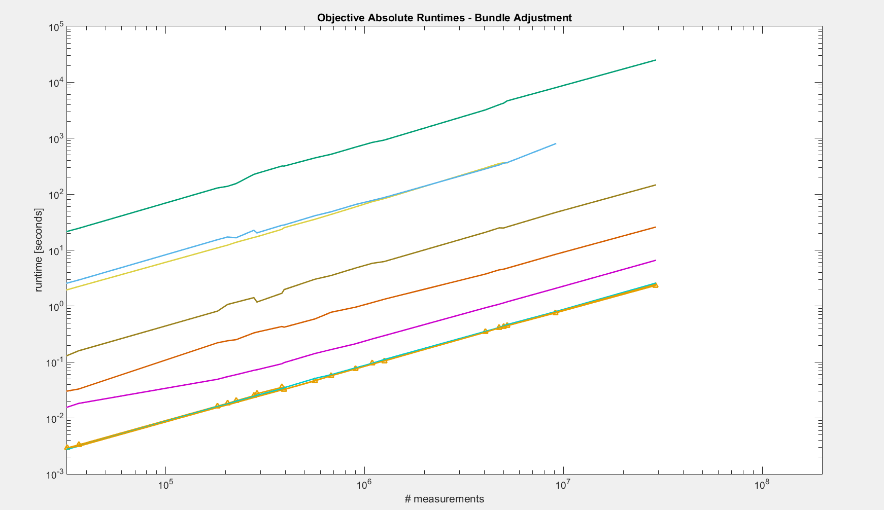
MATLAB
Theano
Python
Julia
F#
MuPAD
C, C++ (clean, Eigen)

Slide 39
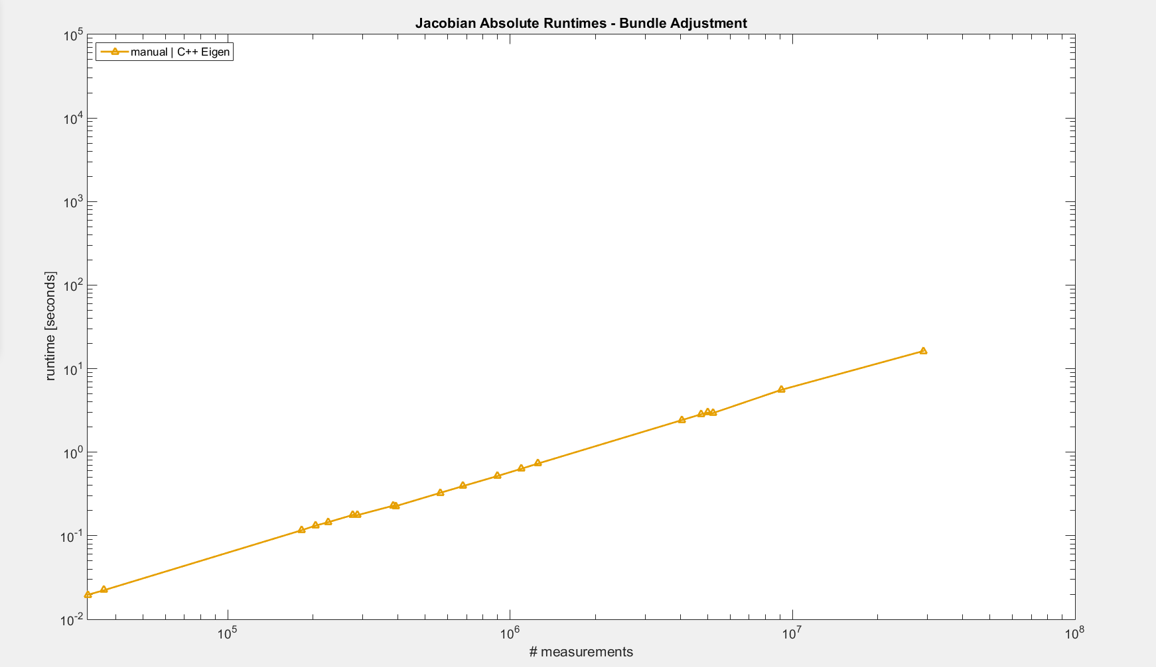
Manual (Eigen)

Slide 40
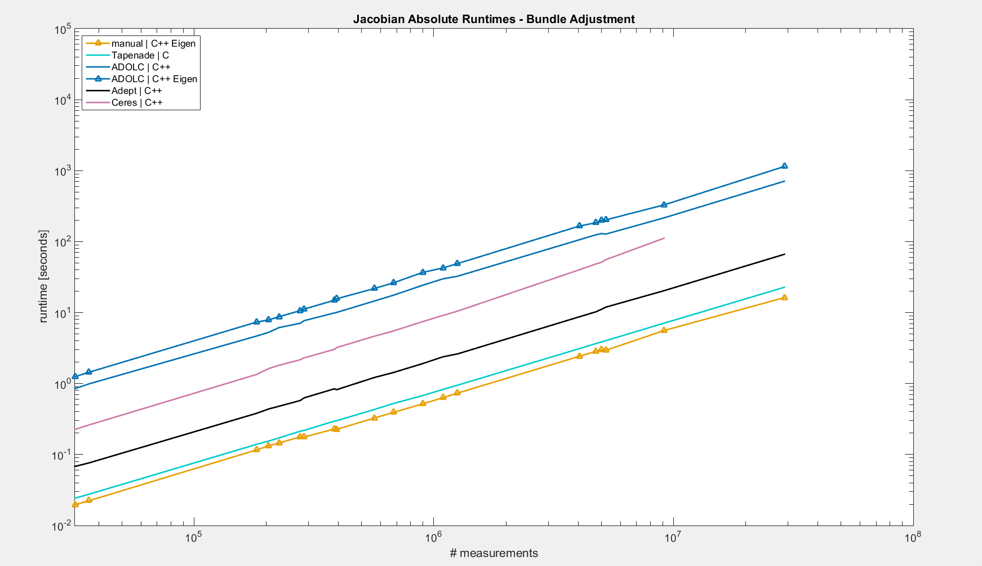
ADOLC (Eigen)
ADOLC
Ceres
Adept
Tapenade
Manual (Eigen)

Slide 41
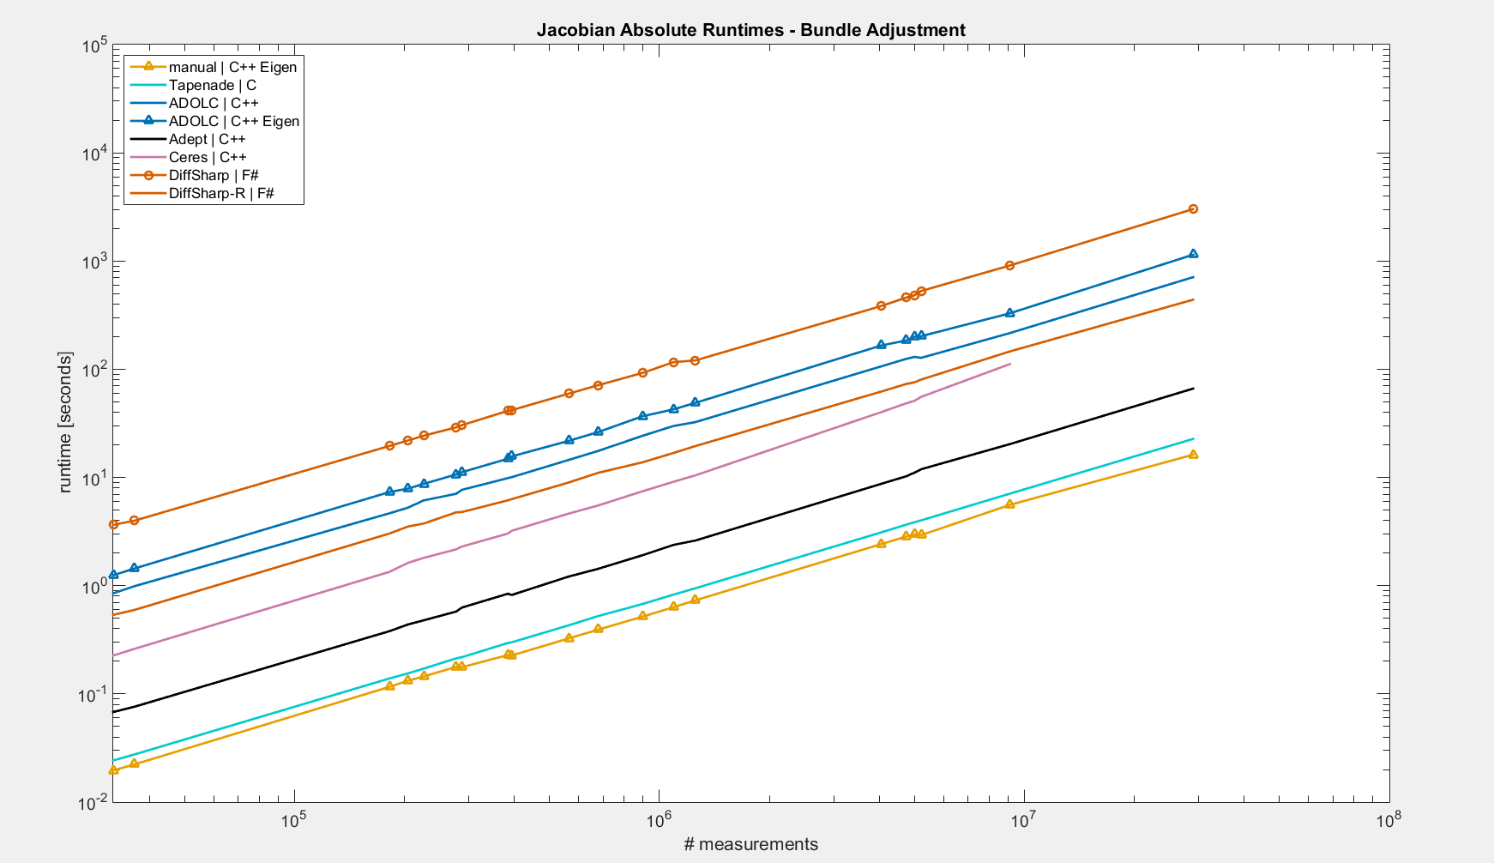
DiffSharp
ADOLC (Eigen)
ADOLC
DiffSharp-R
Ceres
Adept
Tapenade
Manual (Eigen)

Slide 42
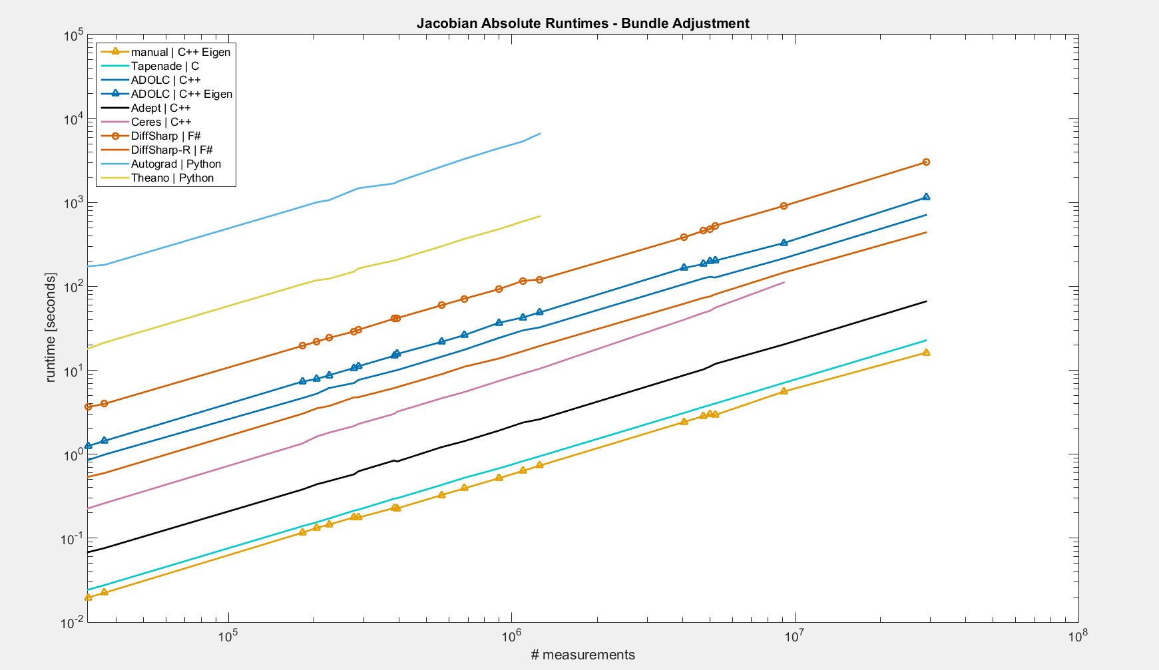
Autograd
DiffSharp
ADOLC (Eigen)
Theano
ADOLC
DiffSharp-R
Ceres
Adept
Tapenade
Manual (Eigen)

Slide 43
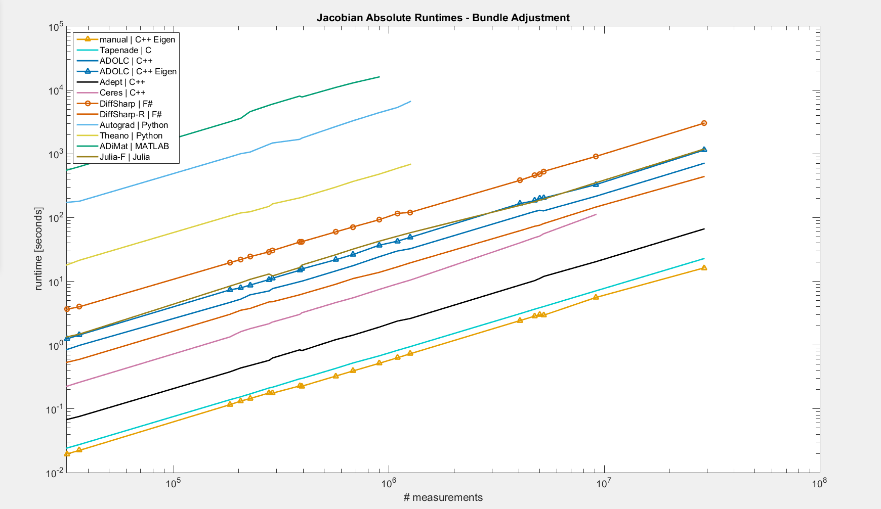
ADiMat
Autograd
DiffSharp
ADOLC (Eigen), Julia-F
Theano
ADOLC
DiffSharp-R
Ceres
Adept
Tapenade
Manual (Eigen)

Slide 44
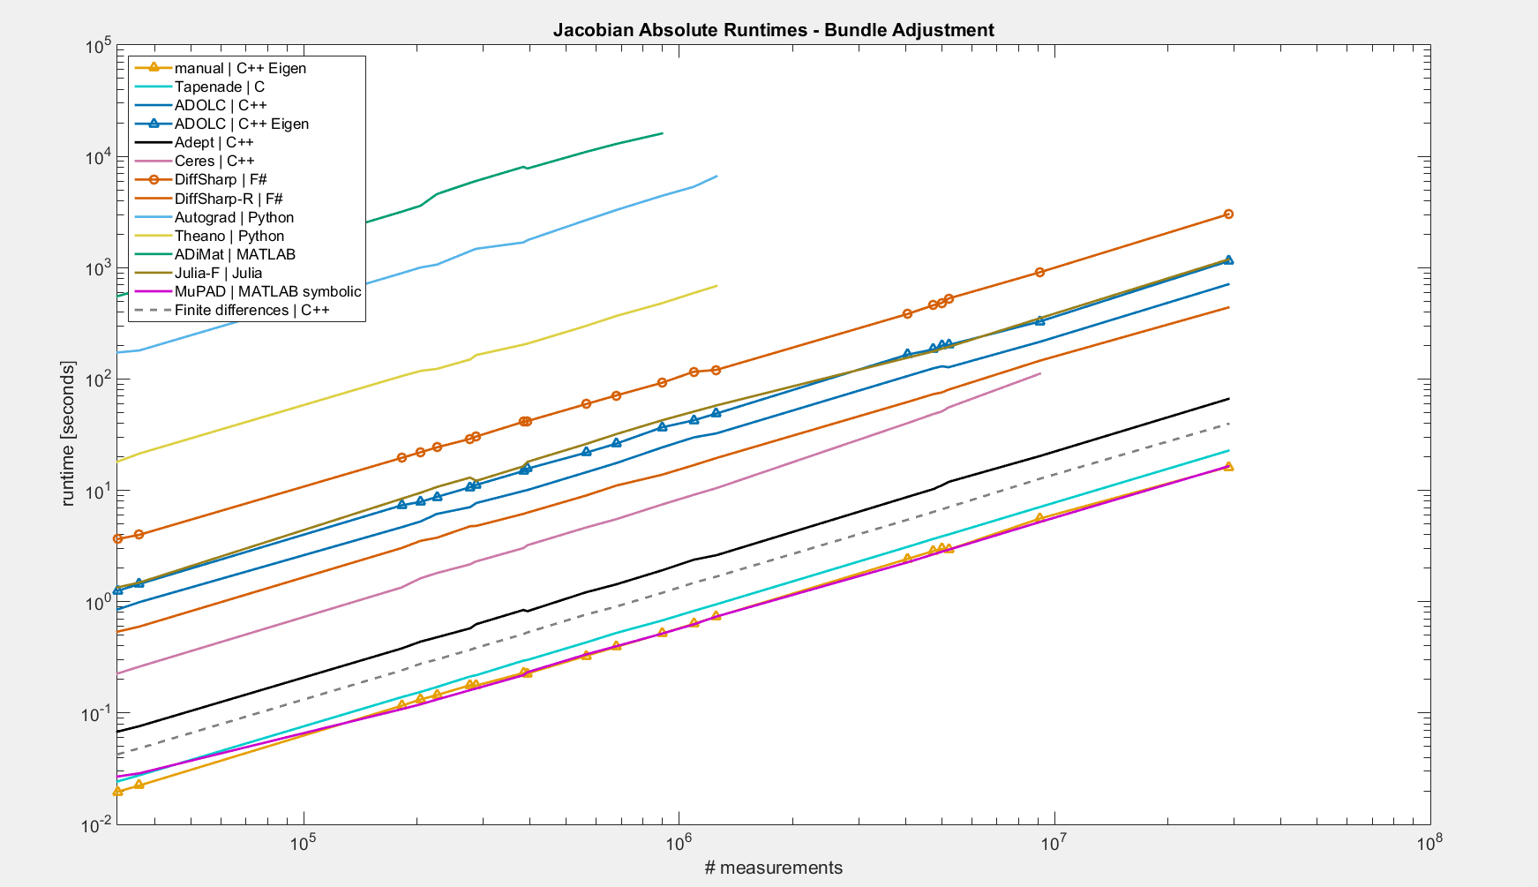
ADiMat
Autograd
DiffSharp
ADOLC (Eigen), Julia-F
Theano
ADOLC
DiffSharp-R
Ceres
Adept
Finite differences (C++)
Tapenade
Manual (Eigen), MuPAD

Slide 45
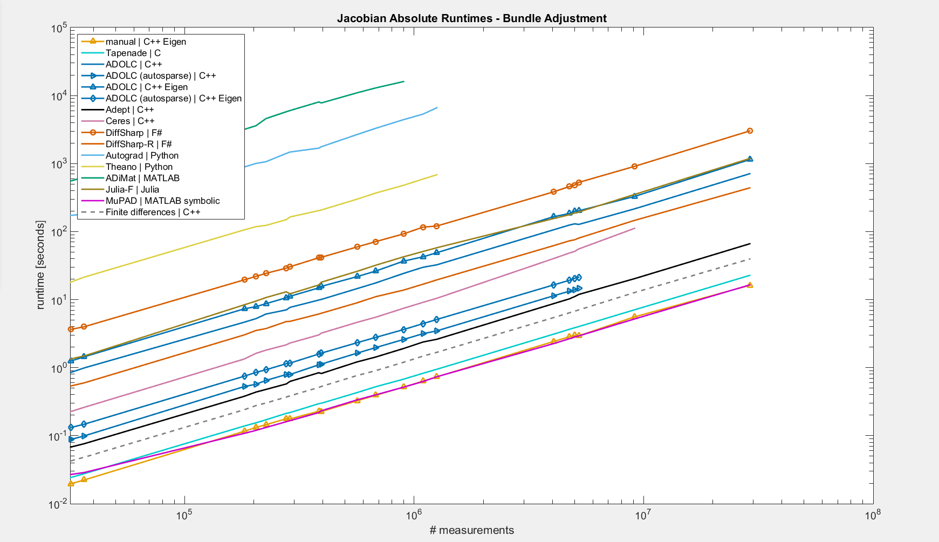
ADiMat
Autograd
DiffSharp
ADOLC (Eigen), Julia-F
Theano
ADOLC
DiffSharp-R
ADOLC autosparse (Eigen)
ADOLC autosparse
Ceres
Adept
Finite differences (C++)
Tapenade
Manual (Eigen), MuPAD
Notes:
sparsity 10 times slower than runtime

Slide 46
Tested Tools - BA
OO – operator overloading, ST – source transformation
F – forward, R – reverse
Language | Tool | Approach | Mode | Ease of use* | Rejection reason
C++ | Adept | OO | F, R | +
C++ | ADOL-C | OO | F, R | +
C++ | Ceres | OO | F | + | memory crash
C/Fortran | Tapenade | ST | F, R | - -
F# | DiffSharp | OO | F, R | +
MATLAB | ADiMat | OO with help of ST | F, R | + +
MATLAB | MuPAD | Symbolic |  | -
Julia | ForwardDiff | OO | F | +
Python | Autograd | OO | R | 0 | memory crash
Python | Theano | Symbolic |  | - | memory crash
*ease of use score can be subjective

Slide 47
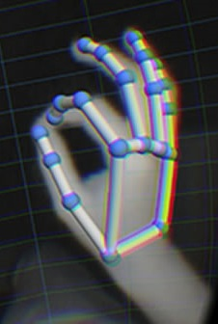
Hand Tracking
Parameters $θ=(r,t,φ)$
Global rotation $r∈ℝ^{3}$
Global translation $t∈ℝ^{3}$
Fingers parameters $φ∈ℝ^{4×5}$
Data:
Hand model vertices $v=ℝ^{3×M}$
Data points $x=ℝ^{3×N}$
Correspondences $c={\left\{1,…,M\right\}}^{N}$
Error:
$e_{i}=x_{i}−transform(v_{c_{i}};θ)$
[http://www.virtualrealityreviewer.com/wp-content/uploads/2014/08/leapmotion-hand-tracking.jpg]

Slide 48
Hand Tracking
Assemble 22 transformations from fingers parameters:
$T∈ℝ^{22×4×4}$
Transform all vertices by all transformations:
$u={\left[T_{i}\left[\begin{matrix}v_{1} & v_{2} & … \\ 1 & 1 & …\end{matrix}\right]\right]}_{i=1}^{22}∈ℝ^{22×4×M}$
Weight by transformations that are relevant:
$z=\sum_{i=1}^{22}{u_{i}w_{i}}∈ℝ^{4×M}$
Apply global rotation and translation
$y=\left[\begin{matrix}R & t \\ 0 & 1\end{matrix}\right]z∈ℝ^{3×M}$
Notes:
transform all vertices first

Slide 49
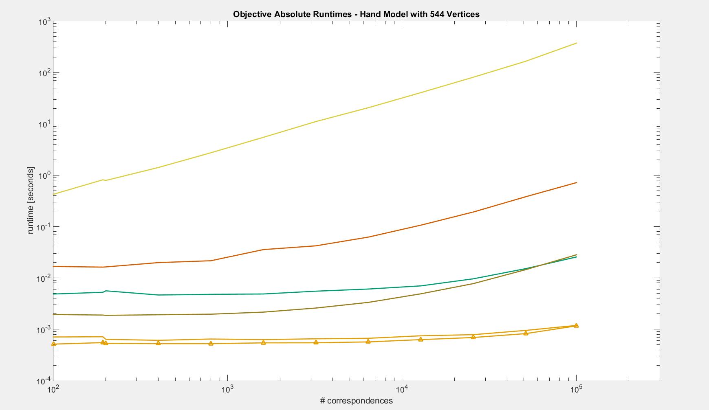
Theano
F#
MATLAB
Julia
C++ (light)
C++ (Eigen)

Slide 50
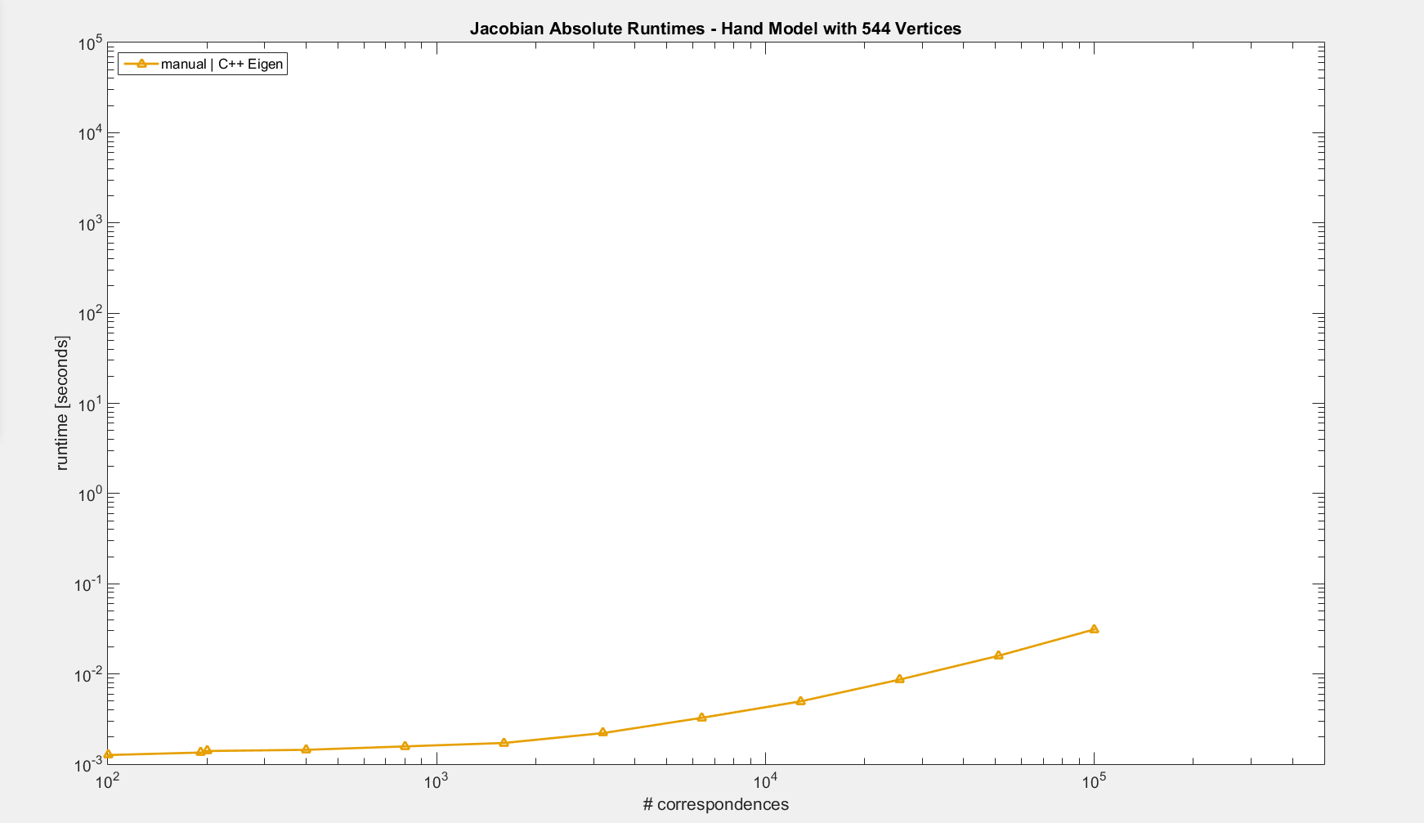
Manual (Eigen)

Slide 51
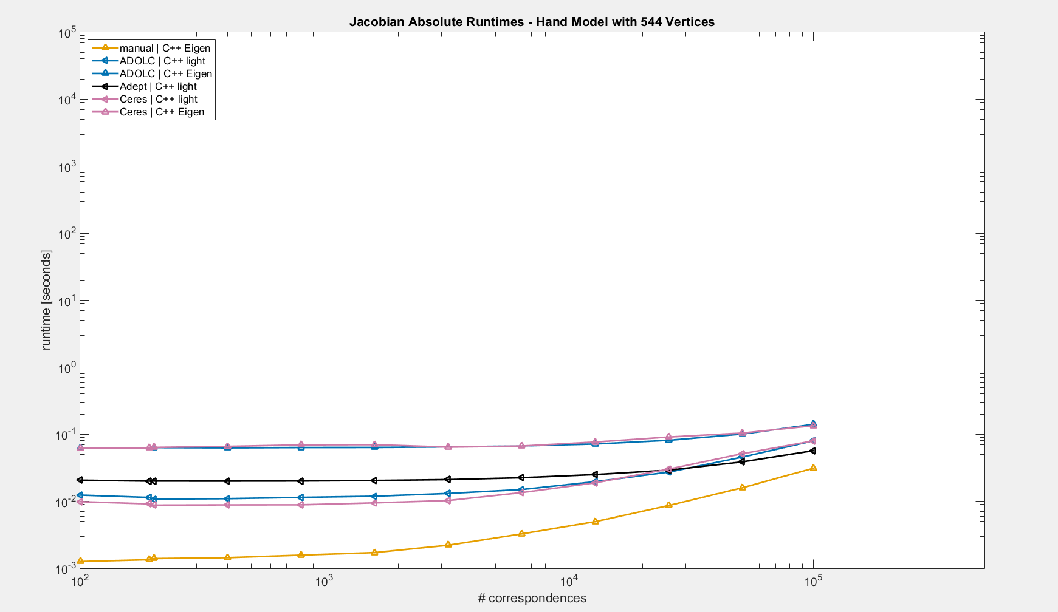
ADOLC (Eigen), Ceres (Eigen)
ADOLC (light), Ceres (light)
Adept (light)
Manual (Eigen)

Slide 52
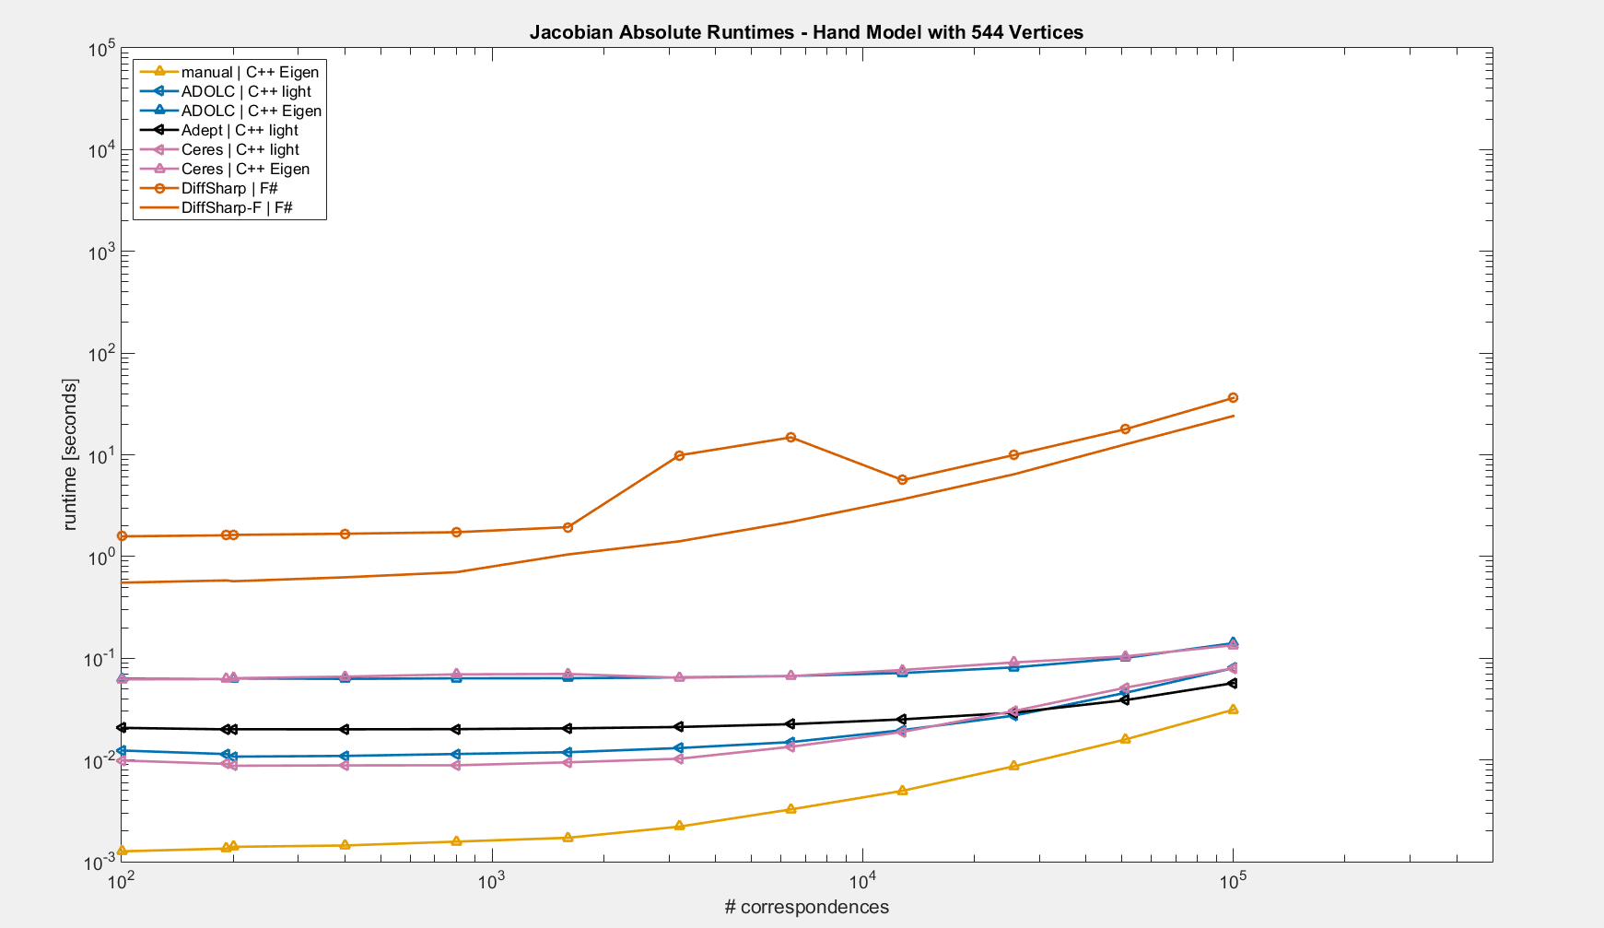
DiffSharp
DiffSharp-F
ADOLC (Eigen), Ceres (Eigen)
ADOLC (light), Ceres (light)
Adept (light)
Manual (Eigen)

Slide 53
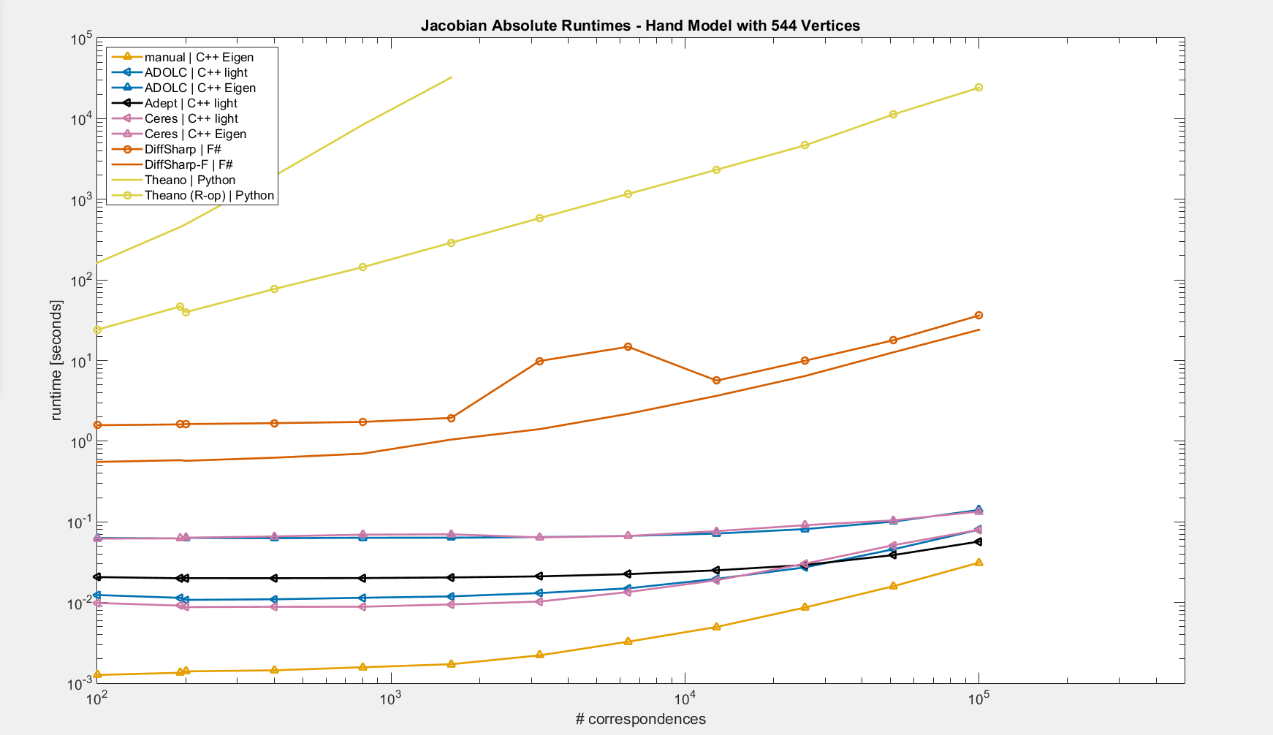
Theano
Theano (R-op)
DiffSharp
DiffSharp-F
ADOLC (Eigen), Ceres (Eigen)
ADOLC (light), Ceres (light)
Adept (light)
Manual (Eigen)

Slide 54
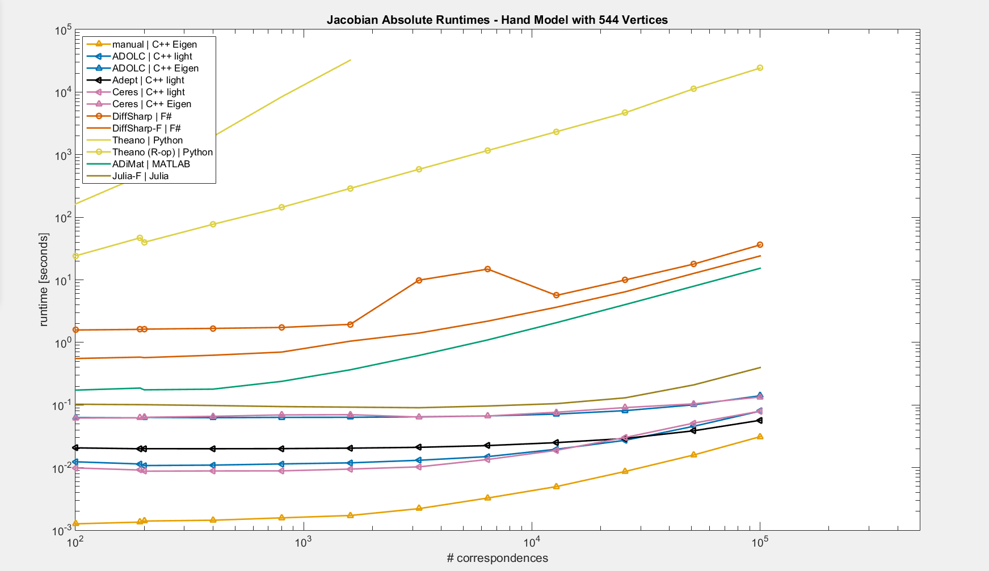
Theano
Theano (R-op)
DiffSharp
DiffSharp-F
ADiMat
Julia-F
ADOLC (Eigen), Ceres (Eigen)
ADOLC (light), Ceres (light)
Adept (light)
Manual (Eigen)

Slide 55
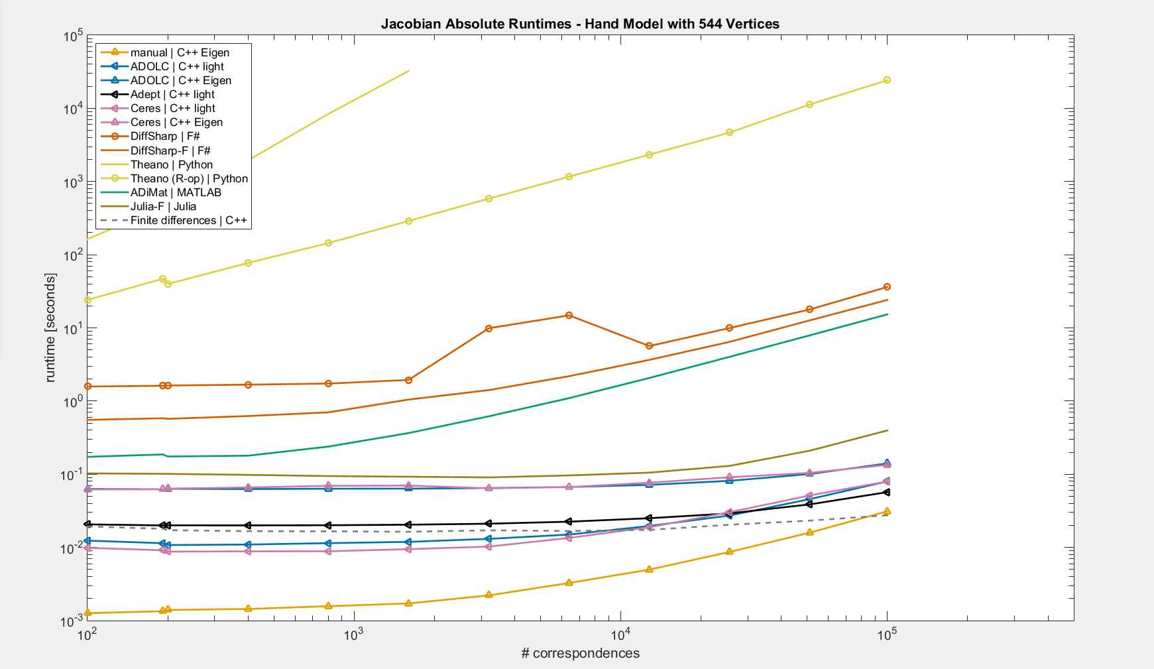
Theano
Theano (R-op)
DiffSharp
DiffSharp-F
ADiMat
Julia-F
ADOLC (Eigen), Ceres (Eigen)
ADOLC (light), Ceres (light)
Adept (light)
Manual (Eigen), Finite differences (C++)

Slide 56
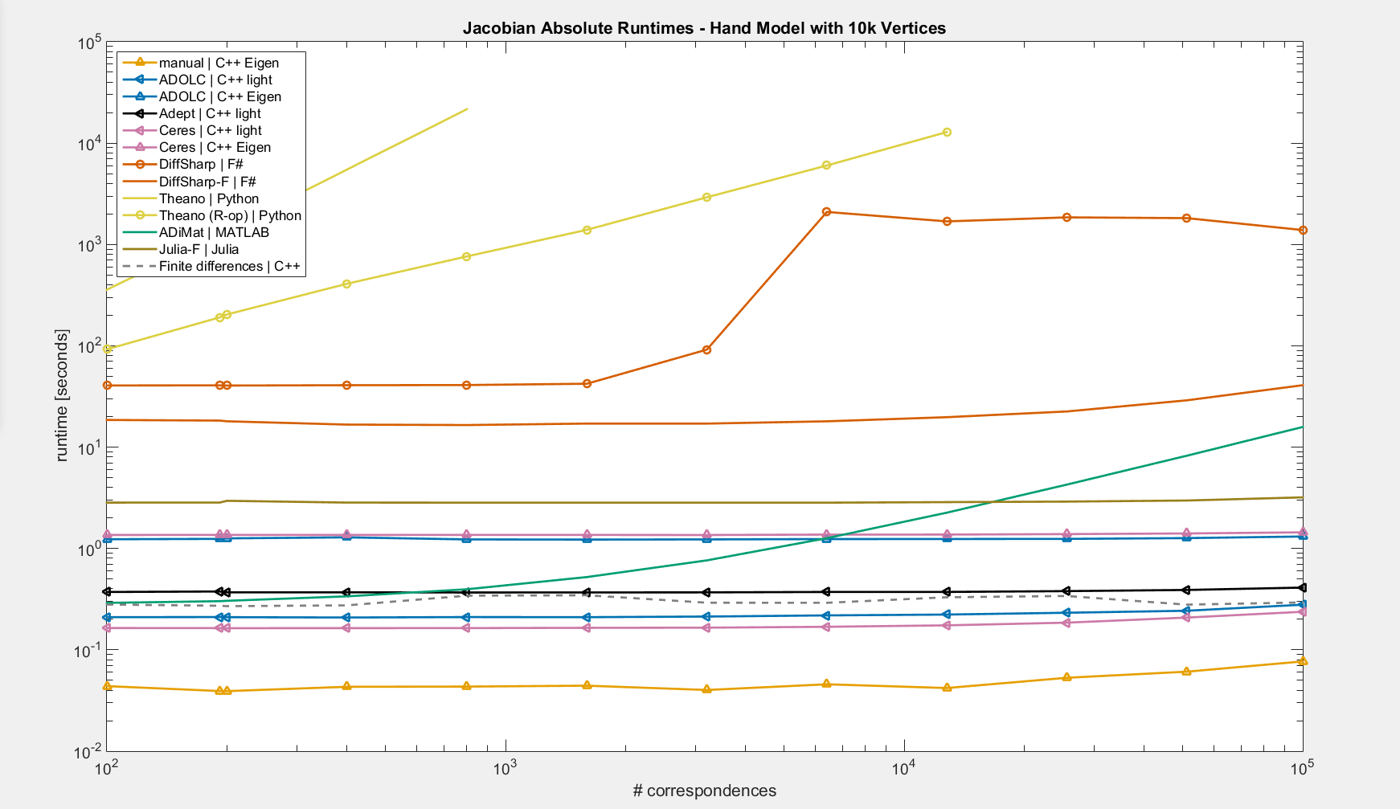

Slide 57
Roaming Correspondences
New parameters:
$u∈ℝ^{2×N}$ (2 for every correspondence)
Correspondences to triangles
$$C$$
$$u_{1}A+u_{2}B+\left(1−u_{1}−u_{2}\right)C$$
$$A$$
$$B$$

Slide 58
Roaming Correspondences
 | $$u_{1}$$ |  | $$u_{2}$$ |  | $$u_{3}$$ |  | $$u_{4}$$ |  | Hand parameters
$${err}_{1}$$
$${err}_{2}$$
$${err}_{3}$$
$${err}_{4}$$
…

Slide 59
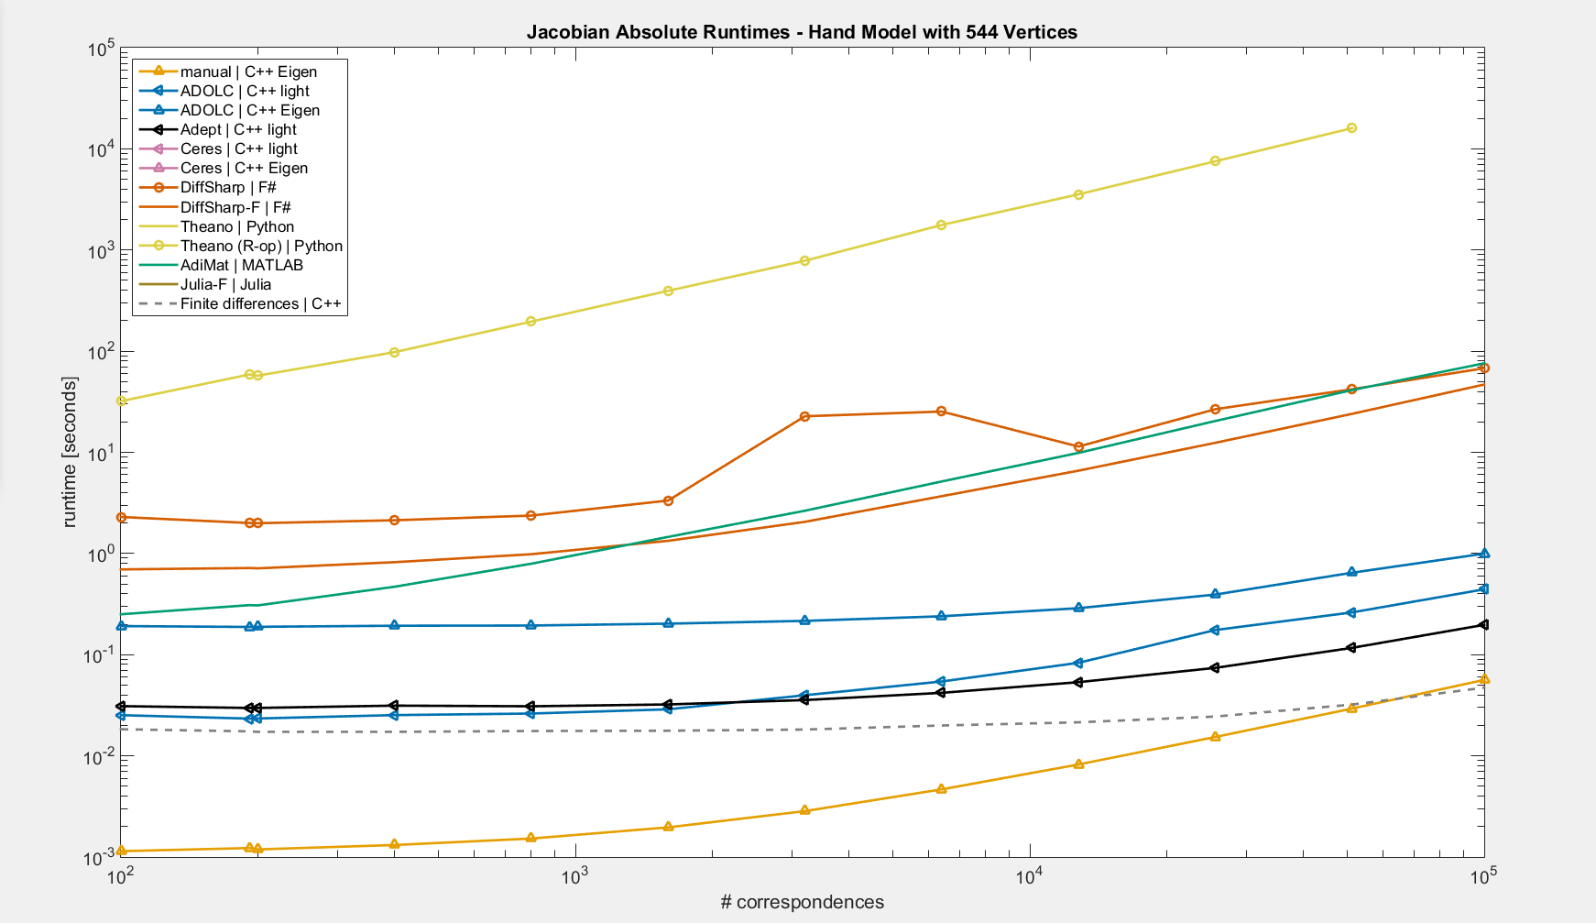

Slide 60
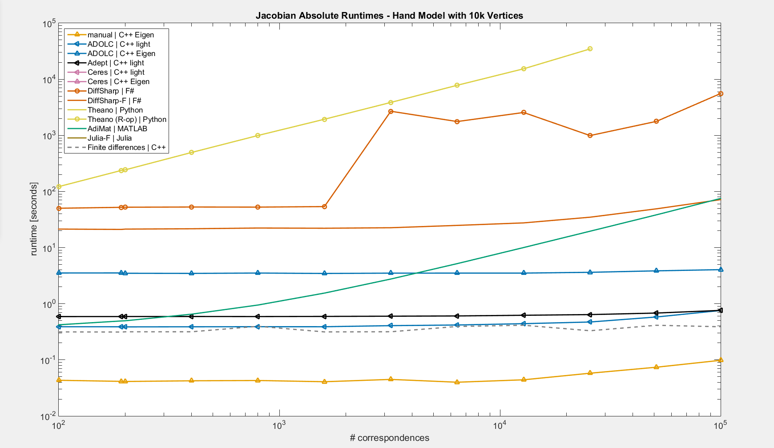

Slide 61
Tested Tools – Hand Tracking
OO – operator overloading, ST – source transformation
F – forward, R – reverse
Language | Tool | Approach | Mode | Ease of use* | Rejection reason
C++ | Adept | OO | F, R | +
C++ | ADOL-C | OO | F, R | +
C++ | Ceres | OO | F | + | sparsity issues
C/Fortran | Tapenade | ST | F, R | - - | only clean C
F# | DiffSharp | OO | F, R | +
MATLAB | ADiMat | OO with help of ST | F, R | + +
MATLAB | MuPAD | Symbolic |  | - | compilation issues
Julia | ForwardDiff | OO | F | + | sparsity issues
Python | Autograd | OO | R | 0 | no forward mode
Python | Theano | Symbolic |  | -
*ease of use score can be subjective

Slide 62
Major drawbacks
Tapenade (C)
Only clean C (Fortran not tested)
Output has to be corrected
Ceres (C++), Julia-ForwardDiff
No reverse mode
Autograd (Python)
No forward mode
Only partial numpy support (e.g. assignments of type A[idx] = x do not work)
MuPAD (MATLAB)
Symbolic $⇒$does not handle big instances (compilation issues)
Theano (Python)
Problematic debugging
Sometimes issues with ifelse, max or eye when nested in a scan ($\sim$loop)

Slide 63
Tested Tools
OO – operator overloading, ST – source transformation
F – forward, R – reverse
Language | Tool | Approach | Mode | Ease of use* | Rejection reason
C++ | Adept | OO | F, R | +
C++ | ADOL-C | OO | F, R | +
C++ | Ceres | OO | F | + | sparsity issues
C/Fortran | Tapenade | ST | F, R | - - | only clean C
F# | DiffSharp | OO | F, R | +
MATLAB | ADiMat | OO with help of ST | F, R | + +
MATLAB | MuPAD | Symbolic |  | - | compilation issues
Julia | ForwardDiff | OO | F | + | sparsity issues
Python | Autograd | OO | R | 0 | no forward mode
Python | Theano | Symbolic |  | -
*ease of use score can be subjective

Slide 64
ADiMat (best ease of use score)
MATLAB
function err = hand_objective(params, data)
...
end
addpath('adimat-0.6.0-4971');
start_adimat
opt = admOptions('independents', [1]);
[J, fval] = admDiffVFor(@hand_objective, 1, params, data, opt);

Slide 65
Adept (ease of use + speed)
C++
#include "adept.h“
using adept::adouble;
vector<double> J(params.size()*err.size());
adept::Stack stack;
vector<adouble> aparams(params.size());
vector<adouble> aerr(err.size());
adept::set_values(&aparams[0], params.size(), &params[0]);
stack.new_recording();
hand_objective(&aparams[0], data, &aerr[0]);
stack.independent(&aparams[0], aparams.size());
stack.dependent(&aerr[0], aerr.size());
stack.jacobian(&J[0]);
adept::get_values(&aerr[0], err.size(), &err[0]);
Inputs:
vector<double> params;
HandData data;
Outputs:
vector<double> err;

Slide 66
AD Cookbook
yes
Only first order derivatives
no
Detecting sparsity automatically
yes
Language | Tool | Mode | Ease of use*
C++ | ADOL-C | F, R | +
yes
Detecting sparsity automatically
no
Nested derivatives
no
no
yes
Language | Tool | Mode | Ease of use*
C++ | Adept | F, R | +
F# | DiffSharp | F, R | +
MATLAB | ADiMat | F, R | + +
Julia | ForwardDiff | F | +
Python | Theano** |  | -
Fortran | Tapenade | F, R | ?
if C++ OK
Language | Tool | Mode | Ease of use*
F# | DiffSharp | F, R | +
Julia | ForwardDiff | F | +
Python | Theano** |  | -
*ease of use score can be subjective
**Autograd if Theano does not work or is too painful to use
Thank you

Slide 67
Gaussian Distribution
$N\left(x;μ,Σ\right)=\frac{1}{\sqrt{\det\left(2πΣ\right)}}\exp\left(−\frac{1}{2}{\left(x−μ\right)}^{⊤}Σ^{−1}\left(x−μ\right)\right)$,
s.t. $Σ$ is positive-semidefinite
$Σ^{−1}=Q^{T}Q$, where $Q=\left[\begin{matrix}\exp\left(q_{1}\right) & 0 & 0 & … \\ l_{1} & \exp\left(q_{2}\right) & 0 & … \\ l_{2} & l_{d} & exp⁡(q_{3}) & … \\ ⋮ & ⋮ & ⋮ & ⋱\end{matrix}\right]$
$$N\left(x;μ,q,l\right)=det⁡(Q(q,l))\frac{1}{\sqrt{\det\left(2πI\right)}}\exp\left(−\frac{1}{2}||Q(q,l)(x−μ)||^{2}\right)$$
Notes:
Cholesky decomposition

Slide 68
Gaussian Mixture Model
$$p\left(x;w,μ,q,l\right)=\sum_{k=1}^{K}{w_{k}N\left(x;μ_{k},q_{k},l_{k}\right)}$$
s.t. $\sum_{k=1}^{K}{w_{k}=1}$
$$w_{k}=\frac{\exp\left(α_{k}\right)}{\sum_{k^{′}=1}^{K}{exp⁡(α_{k^{′}})}}$$
$$p\left(x;α,μ,q,l\right)=\frac{1}{\sum_{k=1}^{K}{exp⁡(α_{k})}}\sum_{k=1}^{K}{\exp{(α_{k})}N\left(x;μ_{k},q_{k},l_{k}\right)}$$
Notes:
Cholesky decomposition

Slide 69
Tested Tools
Language | Tool | Mode | Ease of use* | Sparsity | Derivatives order | Nested derivatives
C++ | Adept | F, R | + | manual | 1st | no
C++ | ADOL-C | F, R | + | automatic | n^{th} | no
C++ | Ceres | F | + | manual** | 1st | no
C/Fortran | Tapenade | F, R | - - | manual | 1st (2nd) | no
F# | DiffSharp | F, R | + | manual | n^{th} | yes
MATLAB | ADiMat | F, R | + + | manual | 1st | no
MATLAB | MuPAD |  | -
Julia | ForwardDiff | F | + | none | n^{th} | yes
Python | Autograd | R | 0 | manual | n^{th} | yes
Python | Theano |  | - | manual | n^{th} | yes
*ease of use score can be subjective
**only when there are independent blocks

Slide 70
Adept (ease of use + speed)
template<typename T>
void hand_objective(
const T* const params,
const HandData& data,
T *err)
{
LightMatrix<T> pose_params;
to_pose_params(params, data.model.bone_names, &pose_params);
LightMatrix<T> vertex_positions;
get_skinned_vertex_positions(data.model, pose_params, &vertex_positions, true);
for (int i = 0; i < data.correspondences.size(); i++)
for (int j = 0; j < 3; j++)
err[i * 3 + j] = data.points(j, i) - vertex_positions(j, data.correspondences[i]);
}

Slide 71
Adept (ease of use + speed)
#include "adept.h“
using adept::adouble;
adept::Stack stack;
vector<adouble> aparams(params.size());
vector<adouble> aerr(err.size());
adept::set_values(&aparams[0], params.size(), &params[0]);
stack.new_recording();
hand_objective(&aparams[0], data, &aerr[0]);
stack.independent(&aparams[0], aparams.size());
stack.dependent(&aerr[0], aerr.size());
stack.jacobian(&J[0]);
adept::get_values(&aerr[0], err.size(), &err[0]);

Slide 72
Adept – sparsity
#include "adept.h“
using adept::adouble;
adept::Stack stack;
vector<adouble> aparams(params.size());
vector<adouble> aus(us.size());
vector<adouble> aerr(err.size());
adept::set_values(&aparams[0], params.size(), &params[0]);
adept::set_values(&aus[0], us.size(), &us[0]);
stack.new_recording();
hand_objective(&aparams[0], data, &aerr[0]);

Slide 73
Adept – sparsity
set_gradients(0., &aparams);
for (size_t i = 0; i < n_pts; i++)
{
aus[2 * i].set_gradient(1.);
aus[2 * i + 1].set_gradient(0.);
}
stack.forward();
adept::get_gradients(&aerr[0], aerr.size(), &J[0]);
1 | 0 | 1 | 0 | 1 | 0 | 1 | 0 | 000000000

Slide 74
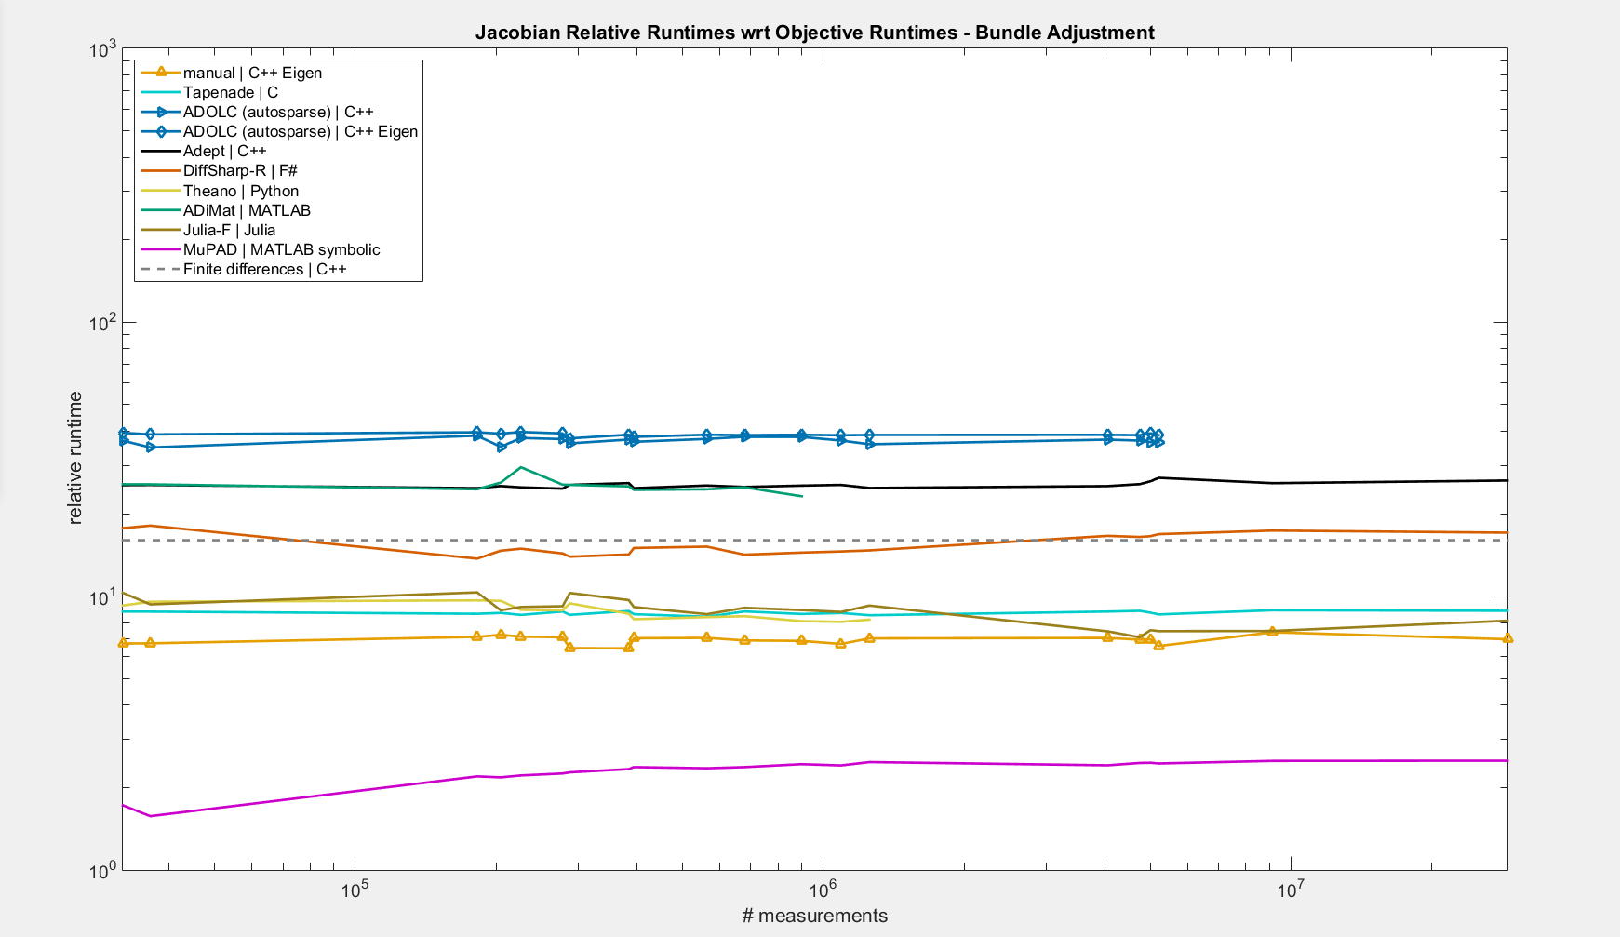
50

Slide 75
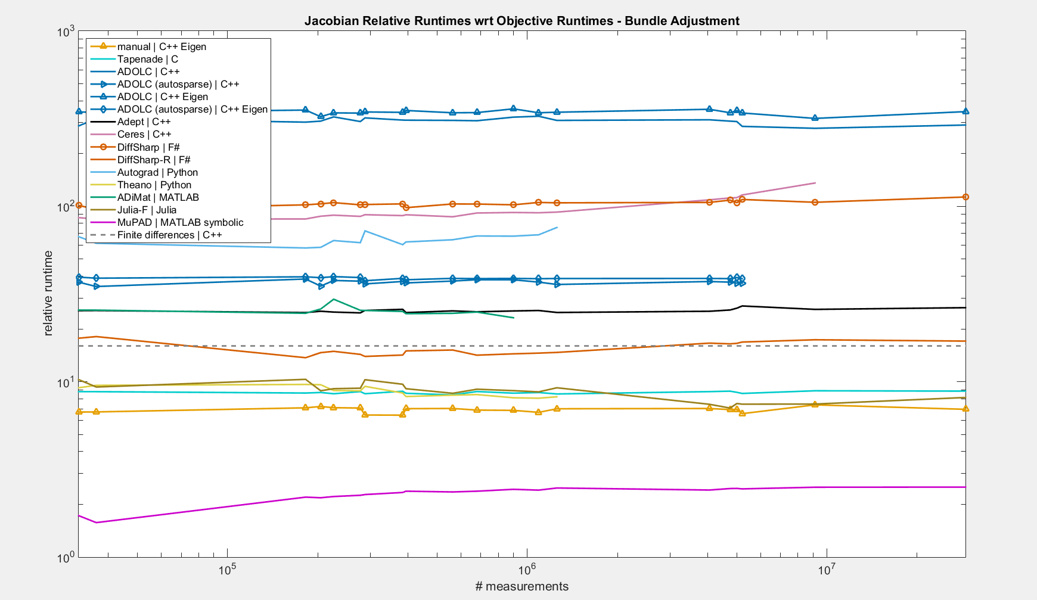
50

Slide 76
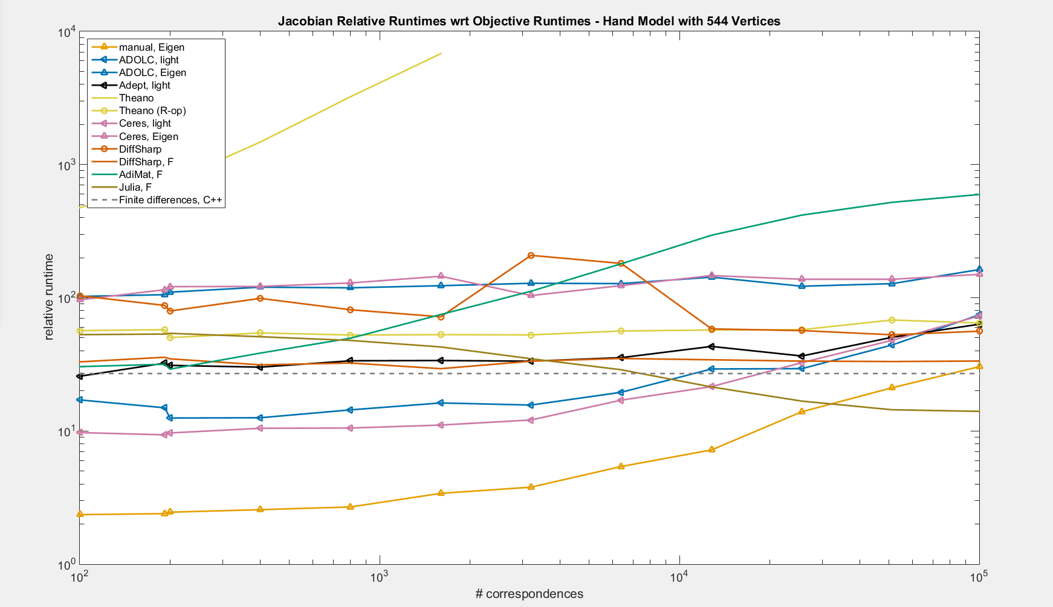

Slide 77
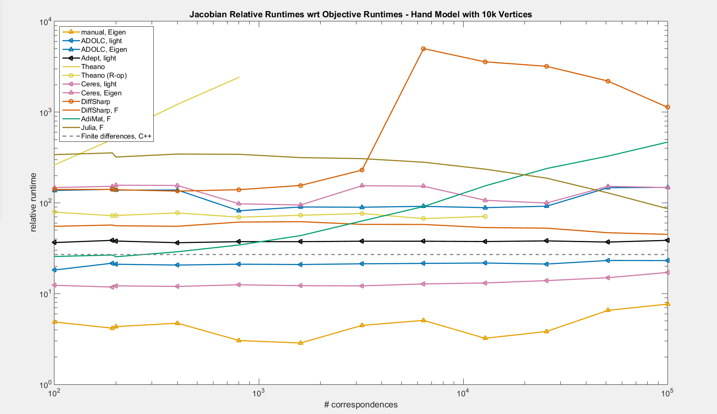

Slide 78
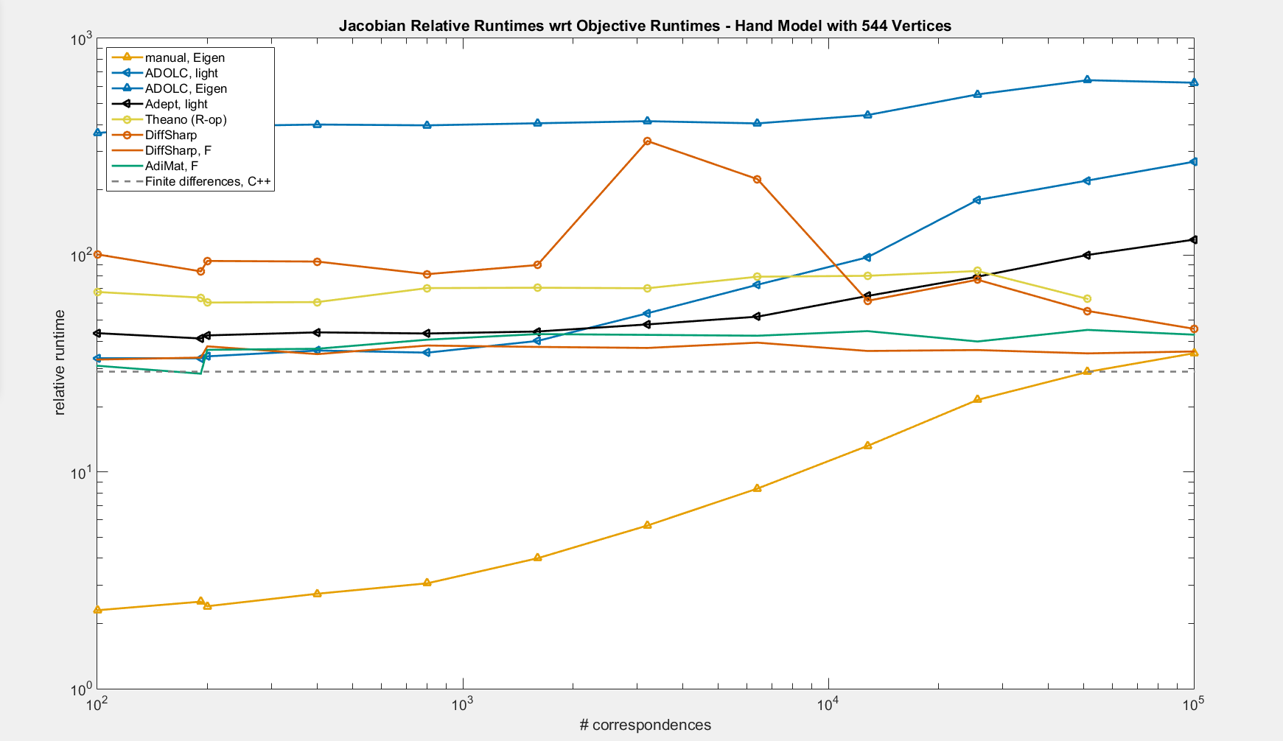

Slide 79
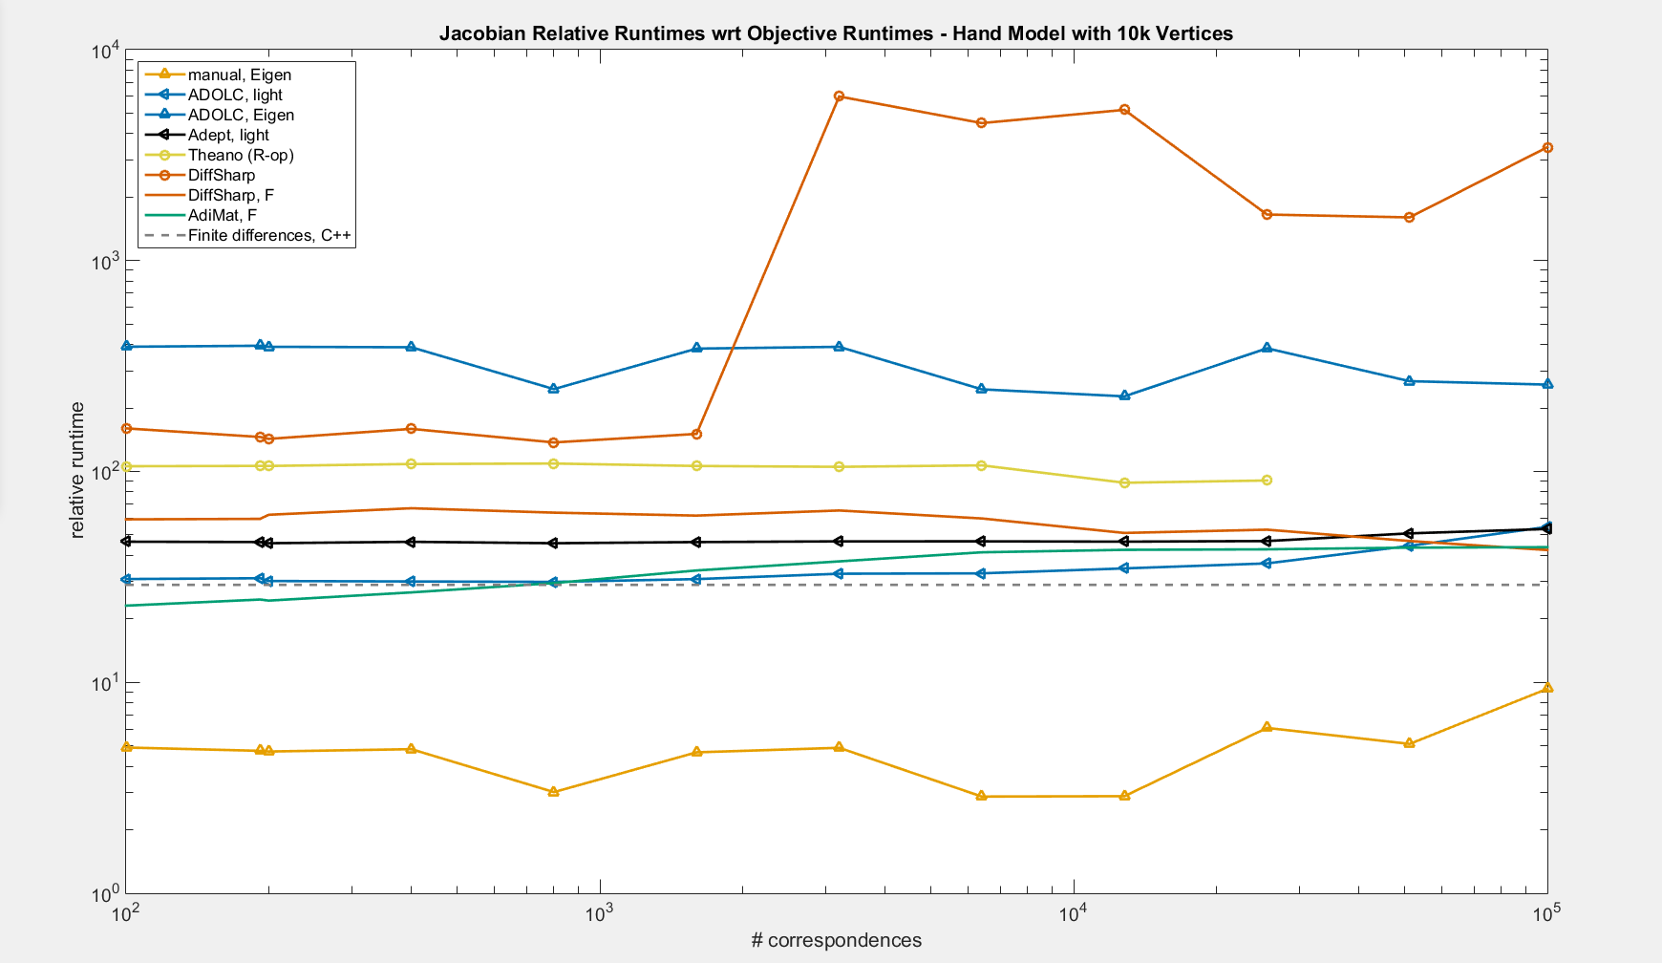

Slide 80
Vector Version
Standard
Vector
...
ysum = 0;
for ix=1:N
y = zeros(1,K);
for ik=1:K
y(ik) = Q{ik}*(x(:,ix) - means(:,ik));
end
ysum = ysum + do_something(y);
end
...
...
y = zeros(K,N);
for ik=1:K
...
y(ik,:) = Q{ik}*(x - repmat(means(:,ik),1,N));
end
ysum = do_something(y);
...

